Slide 1
Biostatistics 3: Exercises day 1
Eva Meglic

Slide 2
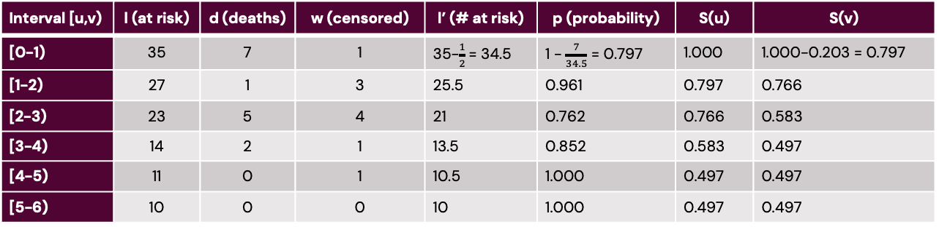

1. Hand calculation: life table (actuarial approach)
Interval [u,v) | l (at risk) | d (deaths) | w (censored) | l’ (# at risk) | p (probability) | S(u) | S(v)
[0-1) | 35 | 7 | 1 | 35-$\frac{1}{2}$= 34.5 | 1 - $\frac{7}{34.5}$ = 0.797 | 1.000 | 1.000-0.203 = 0.797
[1-2) | 27 | 1 | 3 | 25.5 | 0.961 | 0.797 | 0.766
[2-3) | 23 | 5 | 4 | 21 | 0.762 | 0.766 | 0.583
[3-4) | 14 | 2 | 1 | 13.5 | 0.852 | 0.583 | 0.497
[4-5) | 11 | 0 | 1 | 10.5 | 1.000 | 0.497 | 0.497
[5-6) | 10 | 0 | 0 | 10 | 1.000 | 0.497 | 0.497
Adjusted number at risk: l’ = l - $\frac{w}{2}$
Survival probability at the end of the interval: S(v) = S(u) * p
Probability of not experiencing the event (death): p = 1 - $\frac{d}{l′}$
Notes:
Interval [u, v): Time period of interest.
L (at risk): The number of individuals at risk at the beginning of the interval.
D (deaths): The number of deaths due to the event of interest during the interval.
W (censored): The number of individuals censored (lost to follow-up) during the interval.
l' (adjusted at risk): The adjusted number of people at risk during the interval, accounting for censoring.
P (probability of event): The probability of experiencing the event (death) in the interval.
S(u) and S(v): Survival probabilities at the start and end of each interval.
For the probability we can estimate the risk of experiencing an event and also the risk of not experiencing the event → in that case we estimate the cumulative incidence
Actuarial approach uses the adjusted number at risk as it assumes that not all people stay for the whole year → it takes the midpoint of the year

Slide 3
1. Hand calculation: life table (Kaplan-Meier method)
Time t | # at risk | d (deaths) | w (censored) | p (probability) | S(t)
2 | 35 | 1 | 1 | 1-1/35 = 0.971 | 1.000*0.971 = 0.971
3 | 33 | 1 | 0 | 1-1/33 = 0.970 | 0.942
5 | 32 | 1 | 0 | 0.969 | 0.912
7 | 31 | 1 | 0 | 0.968 | 0.884
8 | 30 | 1 | 0 | 0.967 | 0.855
9 | 29 | 1 | 0 | 0.966 | 0.826
11 | 28 | 1 | 0 | 0.964 | 0.796
13 | 27 | 0 | 1 | 1.000 | 0.796
14 | 26 | 0 | 1 | 1.000 | 0.796
Probability of not experiencing the event (death): p = 1 - $\frac{d}{\# at risk}$
Probability of survival past time t: S(t) = S(t - 1) * p
Notes:
Probability of not experiencing the event
S(t) = survival function at time t
main difference:
actuarial approach: estimate time in intervals (which can also be years or months), we also have the adjusted number at risk.
kaplan-meier we use months or years

Slide 4
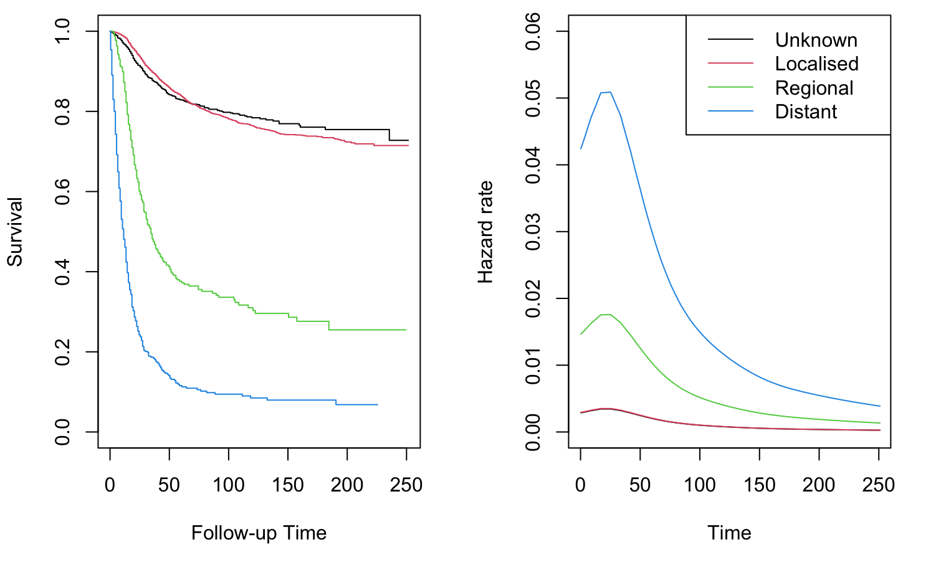
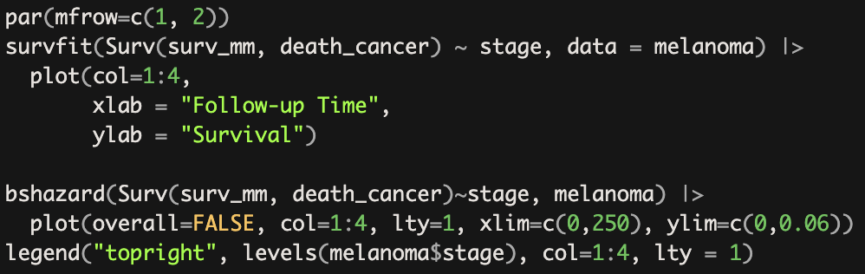
2. Comparing survival proportions and mortality rates by stage for cause-specific and all-cause survival
a) Plot estimates of survival function and hazard function by stage
Notes:
Left Plot: Survival Curves by Cancer Stage
This line creates a Kaplan-Meier survival estimate using the survfit function from the survival package.
Right Plot: Hazard Functions by Cancer Stage
This calculates smoothed hazard estimates using the bshazard function, based on the survfit survival object.
plot(overall=FALSE, col=1:4, lty=1, xlim=c(0,250), ylim=c(0,0.06)):
Plots the hazard functions for each stage, with each line in a different color (col=1:4) and line type (lty=1sets solid lines).
overall=FALSE specifies that the hazard should be plotted separately by stage.
The |> operator passes this survival object to plot(...), which then plots it with specified color and axis labels.
Does it appear that stage is associated with patient survival? Patients in the Regional and Distant stages exhibit significantly worse survival compared to those in the Localized and Unknown stages.
The right plot is not really appropriate in this situation as it assumes that each stage has a different baseline hazard, but that the hazard ratios between stages remain constant over time., however from the graph on the left we see that we can’t claim proportional hazards assumption holds → the lines diverge from each other and the lines for localised and unknown cross each other.
The bshazard() function is estimating the baseline hazard for each stage simultaneously. This means that the function is treating all stages together while computing a separate baseline hazard function for each stage but within the same dataset context.The output would provide a single baseline hazard estimate for each stage, reflecting the risk associated with that stage across the overall population of melanoma patients.
Baseline Hazard Function
The plotted baseline hazard function provides insights into the instantaneous risk of death for melanoma patients at different time points, differentiated by stage.
Higher Baseline Hazard: Indicates a greater risk of mortality at that specific time point.

Slide 5
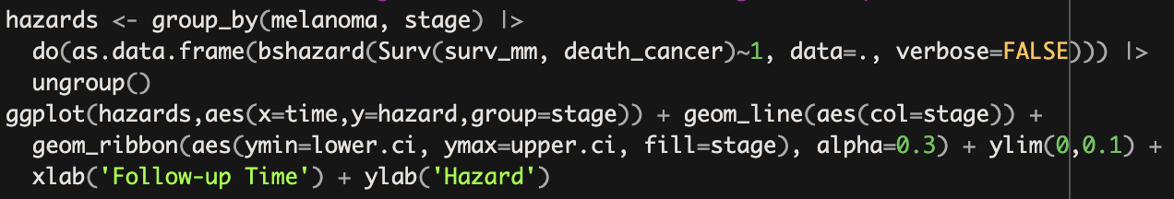
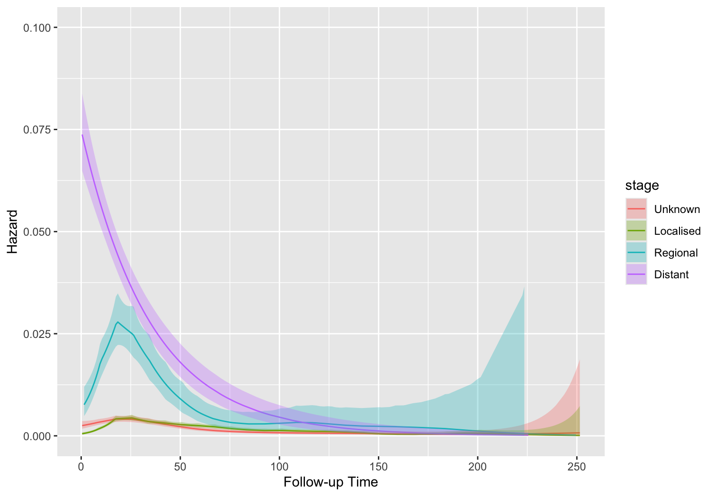
a) Plot hazard function by stage
Notes:
So the better way of plotting the hazard would be like this:
Group Data by Stage:
hazards <- group_by(melanoma, stage) |> → This groups the melanoma dataset by stage.
Calculate Hazard Estimates:
do(as.data.frame(bshazard(Surv(surv_mm, death_cancer)~1, data=., verbose=FALSE))) |>
For each stage, it estimates the hazard function using bshazard(), which computes the risk of death from cancer over time, and converts results to a data frame.
data=. → estimate each baseline hazard within each group separately
ungroup() → Removes the grouping structure, making hazards easier to plot.
Alpha = 0.3 → argument that controls the transparency
Plot with ggplot2:
This creates a plot:
geom_line() draws hazard lines for each stage.
geom_ribbon() adds shaded confidence intervals around each line.
xlab, ylab, and ylim set labels and axis limits.
Again we are looking if the stage is associated with patient survival and we see that it is.
Here, you are grouping the data by stage and then applying bshazard() within each group separately (indicated by data=. in the do() function).This approach computes the baseline hazard function independently for each stage without considering the other stages. This visualization allows you to see the distinct hazard functions for each stage, showcasing how the risk of death changes over time and reflecting the unique characteristics of each stage.

Slide 6
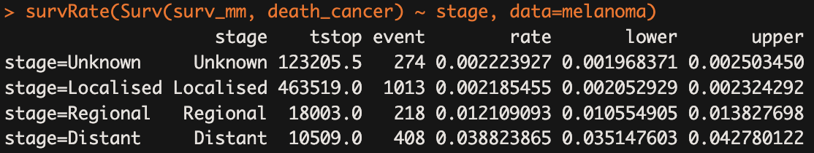
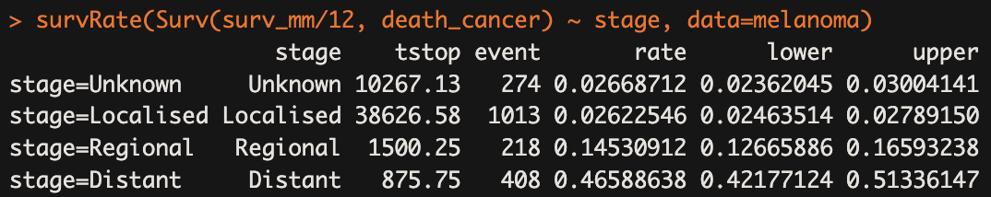
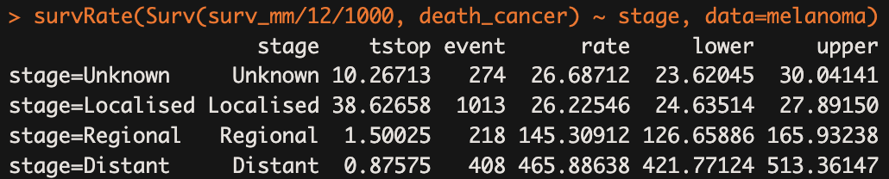
b) Estimate mortality rates for each stage using the SurvRate command
0.22%
0.22%
1.21%
3.88%
c) Estimate mortality rates for each stage per person-year and 1000 person-years
2.67%
2.62%
14.53%
46.59%
26.7/1000 py
26.2/1000 py
145.3/1000 py
465.9/1000 py
Notes:
b) This calculates mortality rates for each stage in terms of events per unit time (in this case, per month since surv_mm is in months).
c) These adjust the mortality rate to per-person year and per-1000 person-years, respectively, giving standardized rates for easier comparison across stages.
stage: The stage of melanoma (e.g., Unknown, Localised, Regional, Distant)
tstop: The total time at risk for each stage. This is typically measured in some time unit (e.g., days, months, or years).
event: The number of events (deaths from cancer) that occurred during the observation period for each stage.
rate: The estimated survival rate for each stage.
lower and upper: The lower and upper confidence intervals for the estimated survival rate.
What are the units of the estimated rates? The rate in the context of survival analysis typically represents the number of events (deaths) per unit of time at risk, which in this case would be per month
Survival Rate Interpretations
Stage: Unknown: Approximately 0.22% of patients died from cancer each month.
Rates per Person-Year
Unknown Stage: 0.0267 per person-year (2.67% annual risk)
This interpretation shows the individual annual risk of death from melanoma for each stage.
Rates per 1,000 Person-Years: The second calculation, with time scaled by 1,000, expresses these rates as deaths per 1,000 person-years, a common scale for large studies:
Per Person-Year Rates
When we say something like "0.0267 per person-year," we can interpret it as a percentage because it applies to a single person over a one-year period → understand individual annual risk (a chance that a person dies from melanoma within a year)
Per 1,000 Person-Years Rates
In the second interpretation, we're considering a rate per 1,000 person-years, which is more suitable when we look at larger populations or longer periods.
By using "per 1,000 person-years," we keep the numbers larger and avoid fractions, making it practical for reporting in studies. This way, instead of percentages, we express the rates as counts per 1,000 person-years, which is common in epidemiological research.
- Confidence intervals are based on the poisson distribution

Slide 7
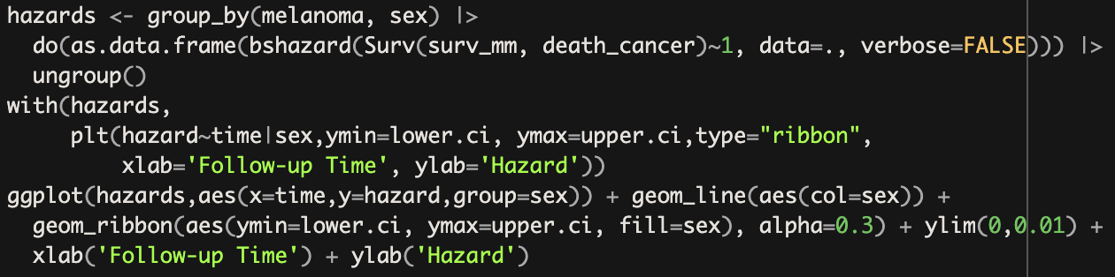
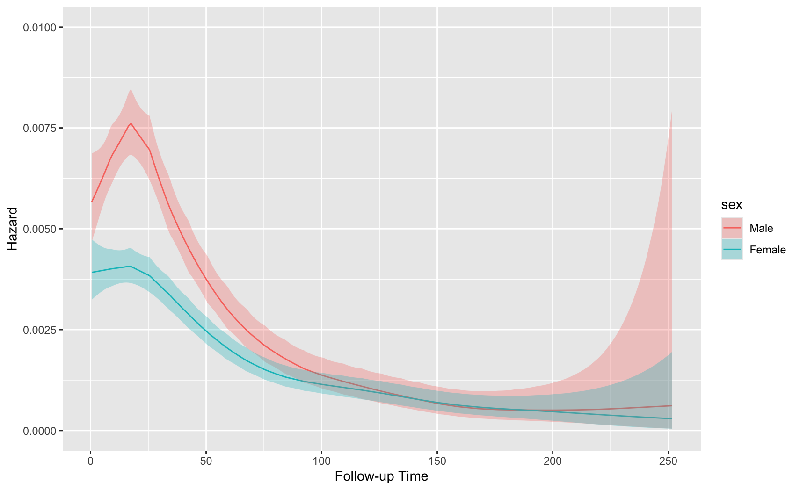
d) Survival difference between sexes
Notes:
hazards <- group_by(melanoma, sex) |> do(as.data.frame(bshazard(Surv(surv_mm, death_cancer) ~ 1, data=.,verbose=FALSE))) |> ungroup() → This groups the melanoma data by sex and applies the bshazard function to calculate hazard rates (time-dependent risk of death due to cancer) for each group. The results are converted into a data frame and stored in hazards.
With allows us to evaluate the expression within a context od a particular data frame, so that we don’t need to constantly repeat it → hazards $ column_name
Plt → plots a hazard function
This uses with and plt to plot hazard rates for each sex group, including confidence intervals as ribbons. The x-axis represents follow-up time, and the y-axis represents hazard rates.
hazard should be plotted against time, grouped by the sex variable
The bshazard() function is used here to calculate the hazard function, which estimates the risk of the event (in this case, death due to melanoma) at each time point.
By grouping the data by sex, we generate separate hazard functions for males and females, allowing for a comparison of risk trends over time.
Is there a difference in survival between males and females? If yes, is the difference present throughout the follow up?
that early on, males face a higher risk of death from melanoma than females
Around the 100-month follow-up mark, the hazard rates for both sexes converge. This implies that, after an initial period of higher risk for males, the risk of death becomes more similar between males and females as time progresses.
The large confidence interval for males toward the end of the follow-up period suggests greater variability or less precise estimates. This typically occurs because there are fewer individuals still at risk at the later time points, especially in groups that had higher hazard rates earlier on, like males. This wider interval reflects increased uncertainty and means that conclusions about the risk at these late stages should be made cautiously.
The pattern suggests that males have a higher early risk, but this risk becomes comparable to females’ risk over time. The larger uncertainty in males' hazard estimates later in the follow-up may also suggest a need to consider other factors (e.g., health interventions or survival characteristics) that could impact long-term survival.

Slide 8
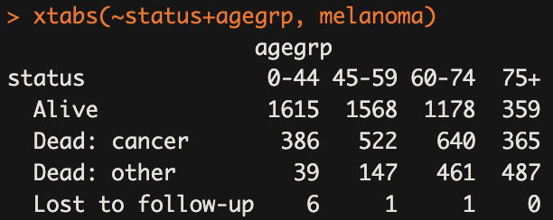
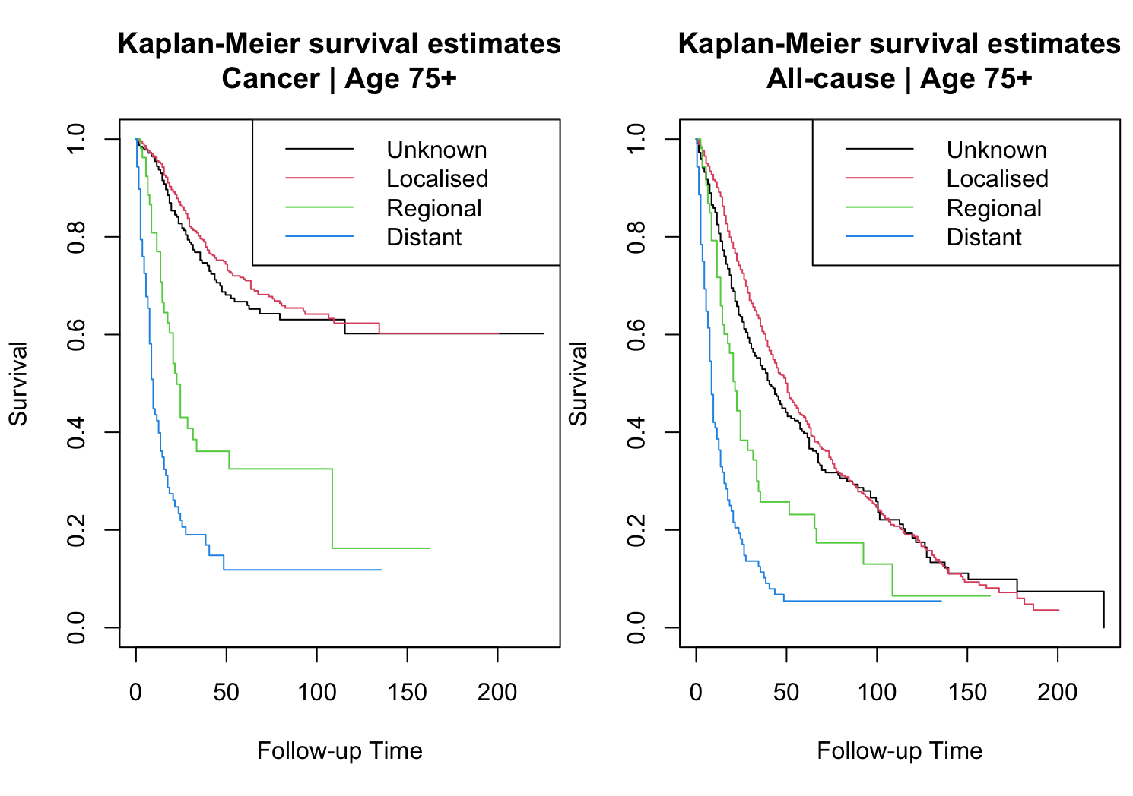
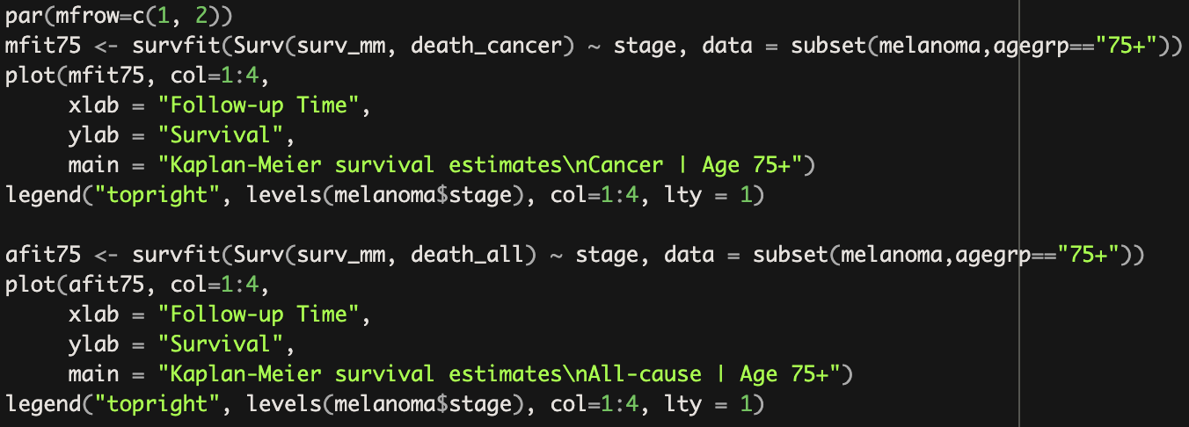
e) How many patients die? Does the distribution of cause of death depend on age?
1913
1134
g) Cause-specific and all cause survival
Notes:
e) How many patients die of each cause? Does the distribution of cause of death depend on age?
Yes, the distribution of the cause of death depends on age. For younger age groups, cancer is the predominant cause of death among those who have died. As age increases, however, deaths from other causes become more common, especially in the 75+ age group where other causes of death actually exceed cancer-related deaths. This suggests a shifting pattern with age, where competing risks play an increasingly significant role in survival outcomes.
g) It is more common to die from a cause other than cancer in older ages. How does this impact the survivor proportion for different stages? Compare cause-specific and all-cause survival by plotting the survivor proportion by stage for the oldest age group (75+ years) for both cause-specific and all-cause survival
- First Plot (Cancer-Specific Survival): This plot shows how long patients with melanoma aged 75+ are expected to survive given they die from cancer. Typically, you might see that higher stages (more advanced disease) have poorer survival rates compared to lower stages, as expected.
- Second Plot (All-Cause Survival): This plot provides a broader view, taking into account all causes of death. For older adults, particularly those aged 75 and above, it is common to see a higher likelihood of dying from causes other than cancer (e.g., heart disease, other illnesses), which may lead to higher survival estimates across stages compared to cancer-specific survival.

Slide 9
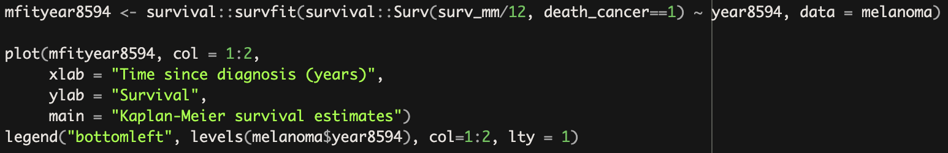
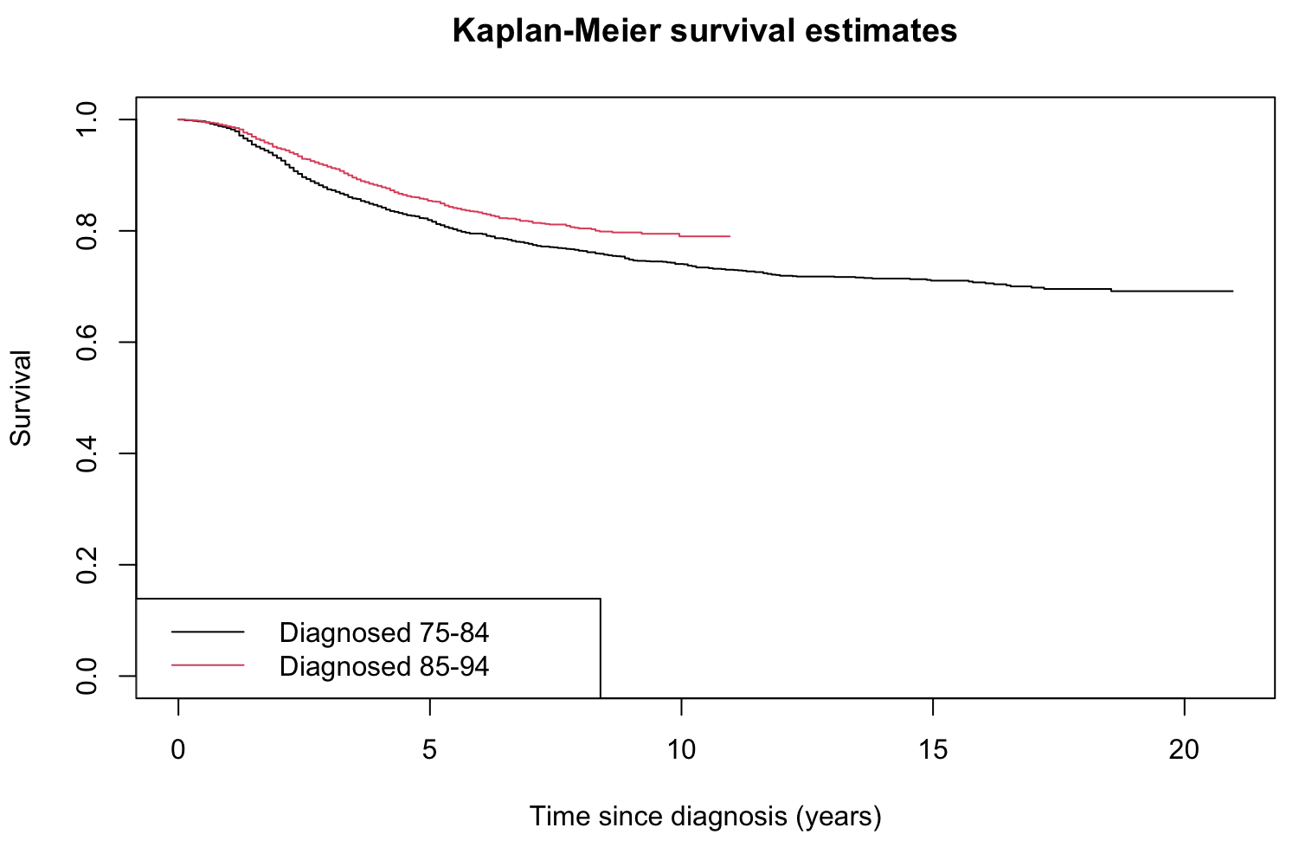
3. Localized melanoma: comparing estimates of cause specific survival between periods
a) Is survival superior in the most recent years?
Notes:
This line uses survival::survfit to create a Kaplan-Meier survival estimate.
Surv(surv_mm / 12, death_cancer == 1) specifies the survival object, where surv_mm / 12 represents survival time in years, and death_cancer == 1 is the event indicator (i.e., death due to cancer).
~ year8594 indicates that survival estimates should be stratified by the year8594 variable (presumably indicating whether the melanoma diagnosis was in the years 1985-1994 or not).
a) There seems to be a clear difference in survival between the two periods. Patients diagnosed during 1985–94 have superior survival to those diagnosed 1975–84.

Slide 10
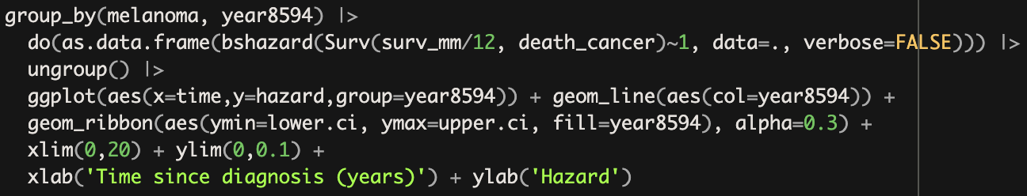
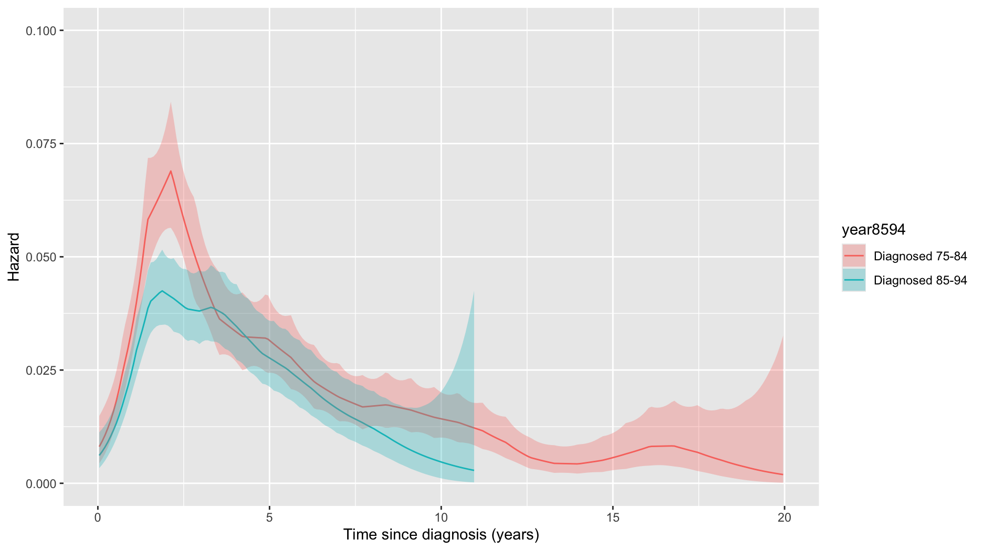
b) Plot the hazard function – at what time is the mortality the highest?
Notes:
group_by(melanoma, year8594) groups the data by year8594.
do(as.data.frame(...)) computes hazard estimates for each group and converts the results to a data frame.
ggplot(aes(x=time, y=hazard, group=year8594)) initializes the plot with time on the x-axis and hazard on the y-axis.
geom_line(aes(col=year8594)) adds a line for each year8594 level, with colors representing different groups.
geom_ribbon(aes(ymin=lower.ci, ymax=upper.ci, fill=year8594), alpha=0.3) adds a shaded confidence interval for each group’s hazard function.
At what point in the follow-up is mortality highest?
Does this pattern seem reasonable from a clinicial/biological perspective?
- The plots suggest that early-diagnosed patients experience a higher risk of mortality shortly after diagnosis, as indicated by the steeper rise in the hazard function.
People diagnosed have a more advanced melanoma stage at the time of the diagnosis
There are different treatment approaches over time
Clinical/Biological Interpretation
1. Stage at Diagnosis:
Patients diagnosed earlier may represent those with more advanced stages of melanoma at the time of initial diagnosis, leading to a higher risk of mortality in the first few years post-diagnosis.
Advances in screening and awareness over time may have led to earlier detection of less aggressive tumors in later cohorts, resulting in lower initial hazard rates.
2. Improvements in Treatment:
Over the years, treatment for melanoma has improved significantly, particularly with the advent of targeted therapies and immunotherapy. This could lead to better outcomes for patients diagnosed later, contributing to a lower peak hazard.
The lower peak hazard for those diagnosed later might indicate that they have benefited from improved treatment protocols, leading to reduced mortality risk.
3. Survivorship Bias:
Early diagnosis may also be associated with patients who had less comorbid conditions, allowing for a more accurate reflection of melanoma-related mortality. Conversely, later-diagnosed patients might include those who were more symptomatic or had comorbidities, possibly affecting survival.
4. Biological Behavior of the Tumor:
The biology of melanoma tumors can vary, and earlier diagnoses might coincide with more aggressive tumor characteristics that manifest as higher mortality in the initial years.
As treatments improve and become more personalized, the biological behavior of tumors may also adapt, leading to different mortality patterns over time.

Slide 11
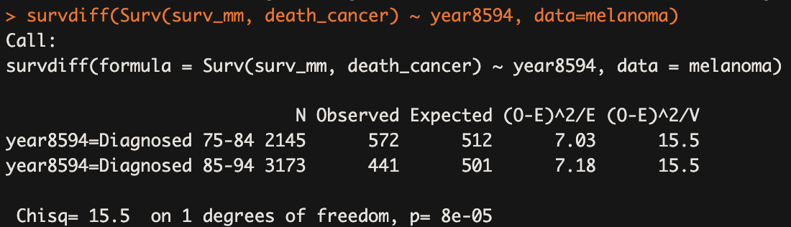
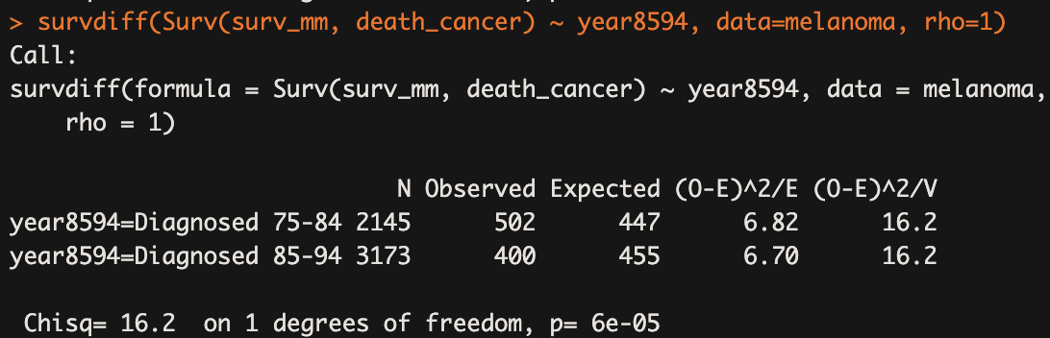
c) Log-rank and Wilcoxon test – test if the patient survival difference is significant
Notes:
They are both non-parametric statistical tests used to compare survival distributions between two or more groups. However, they have different sensitivities and assumptions, so the choice between them depends on the data and the research question.
When to Use Each Test
Log-Rank Test: gives equal weight to all time points → sensitive to differences in survival rates across the full timeline, Use when you expect a consistent difference in survival rates over time, especially when hazards are proportional. (e.g., a new treatment that consistently lowers risk)
Wilcoxon Test: gives more weight to differences in survival rates at earlier time points → sensitive to early differences in survival; Use when early differences in survival are expected, such as when one group has a high risk initially that diminishes later. (a new treatment initially reduces but is less effective long-term)
We see that there is a significant difference in survival between patients diagnosed in 75-84 and 85-94: we see that from the observed vs expected
When do we use one or the other?

Slide 12
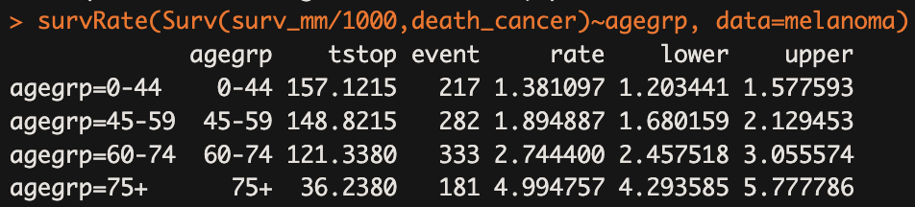
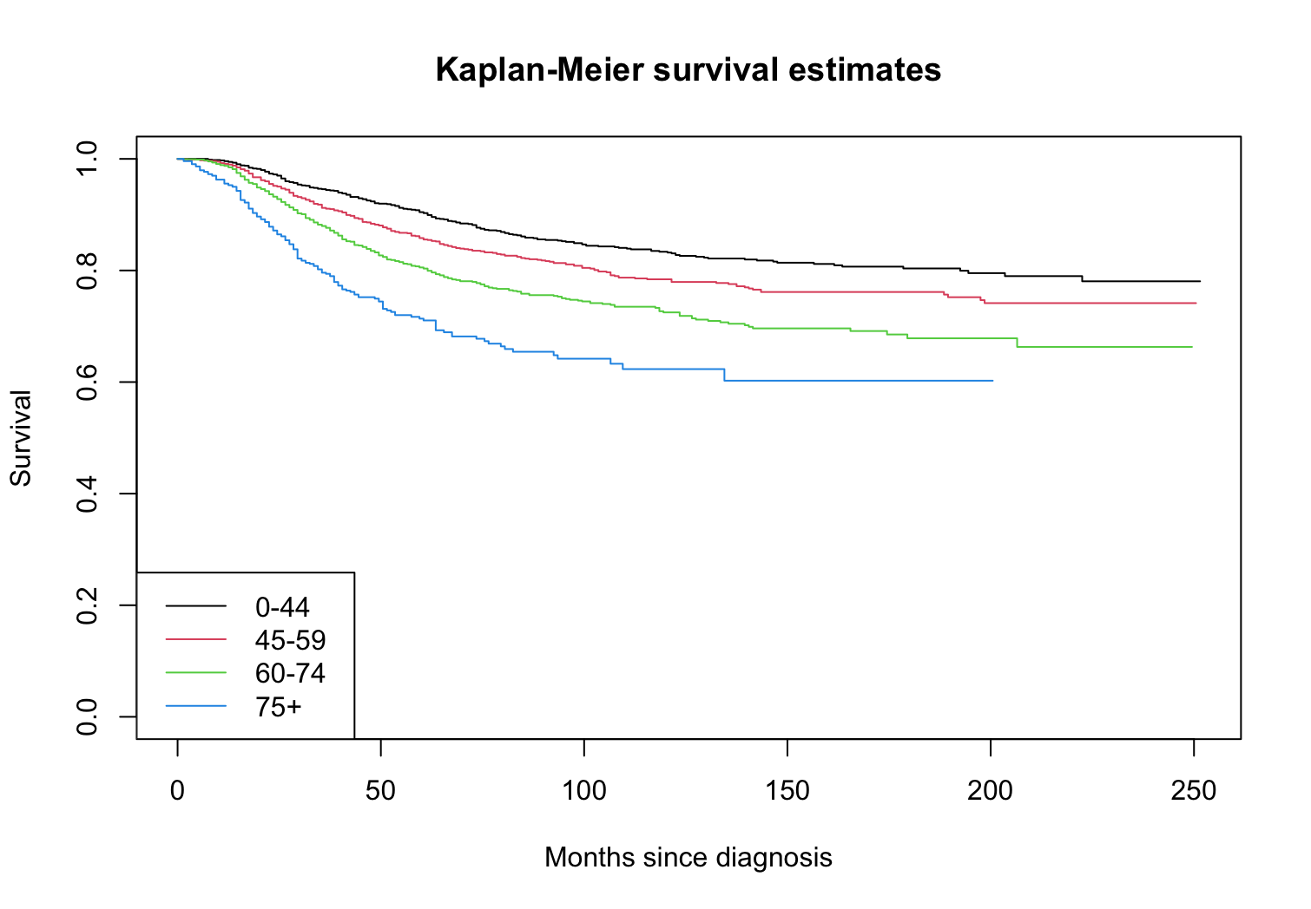
d) Estimate cause-specific survivorship for each age group
Notes:
We create a survival object and we group the mortality estimates by different age groups.
d) Estimate cause-specific mortality rates for each age group, and graph Kaplan-Meier estimates of the cause-specific survivor function for each age group. Are there differences between the age groups? Is the interpretation consistent between the mortality rates and the survival proportions?
The mortality rate increases with age:
This trend indicates that older patients have a significantly higher risk of dying from melanoma.
All age groups show non-overlapping confidence intervals, which suggests statistically significant differences in mortality rates between the groups.
Key Takeaway: Older melanoma patients have significantly higher cause-specific mortality rates and lower survival probabilities compared to younger patients. This finding highlights the increased vulnerability of older patients to both the disease and its effects over time.
What are the units of the estimated hazard rates? per 1,000 person-years

Slide 13
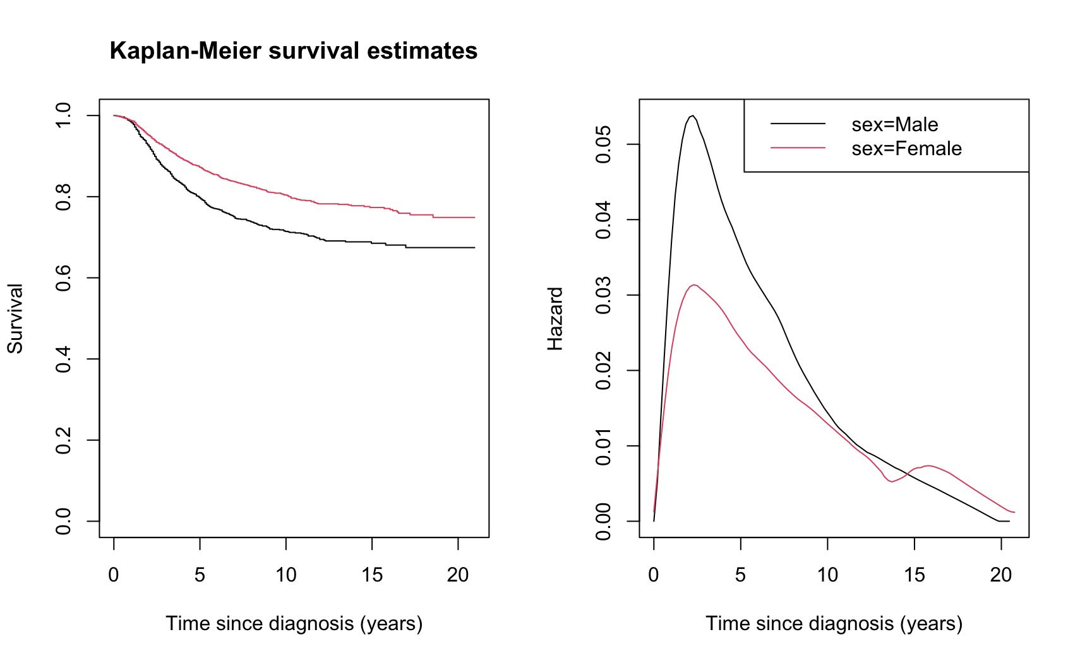
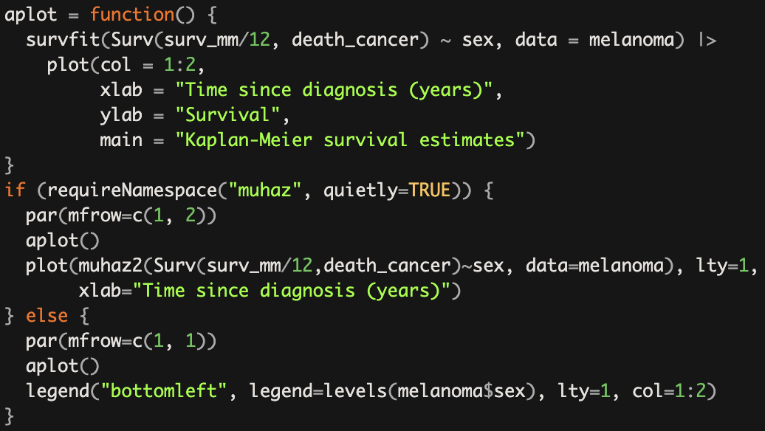
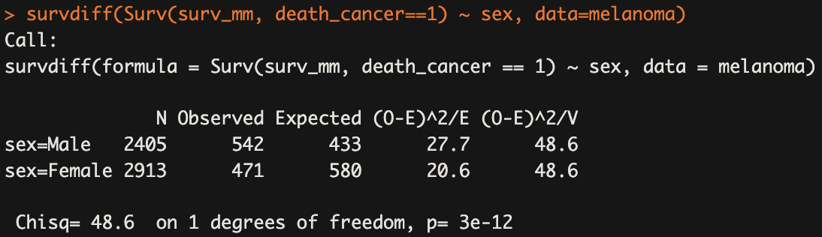
f) Is there a difference in patient survival between males and females?
Notes:
This block defines a function named aplot. → fit a Kaplan-Meier survival curve
The if statement checks if the muhaz package is installed and can be loaded (without throwing an error) using requireNamespace().
If muhaz is available:
par(mfrow=c(1, 2)) sets up the plotting area to show two plots side by side.
It calls aplot() to create and display the Kaplan-Meier survival estimates.
Then it uses the muhaz2() function to plot hazard estimates (the hazard function) for each sex group in the dataset. This function likely produces a smoothed estimate of the hazard function over time.
If muhaz is not available:
par(mfrow=c(1, 1)) sets the plotting area to show only one plot.
It again calls aplot() to display the Kaplan-Meier survival estimates.
A legend is added to the plot using legend(), identifying the different curves for male and female based on the levels of the sex factor.
Statistical Significance: The log-rank test results indicate a highly significant difference in survival between male and female patients with melanoma. The very small p-value (3e-12) suggests that the survival curves for the two sexes are not the same.

Slide 14
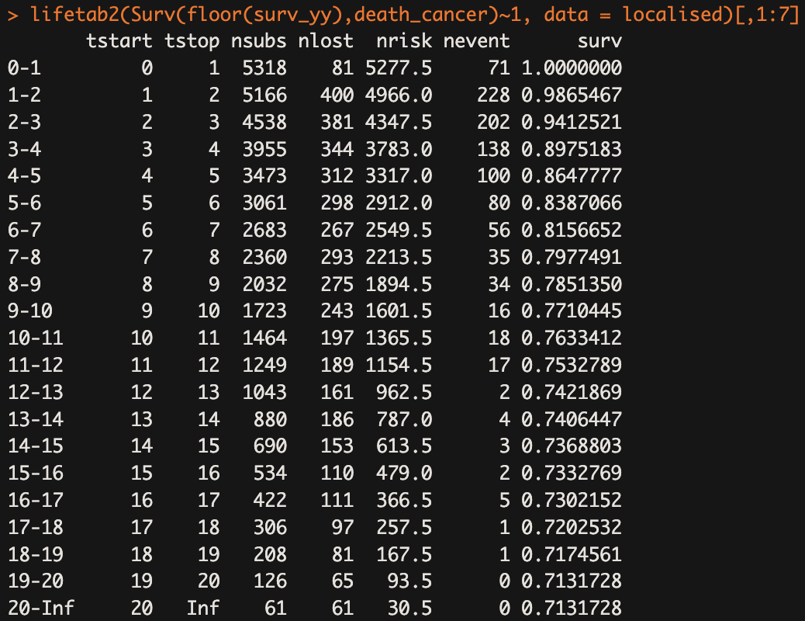
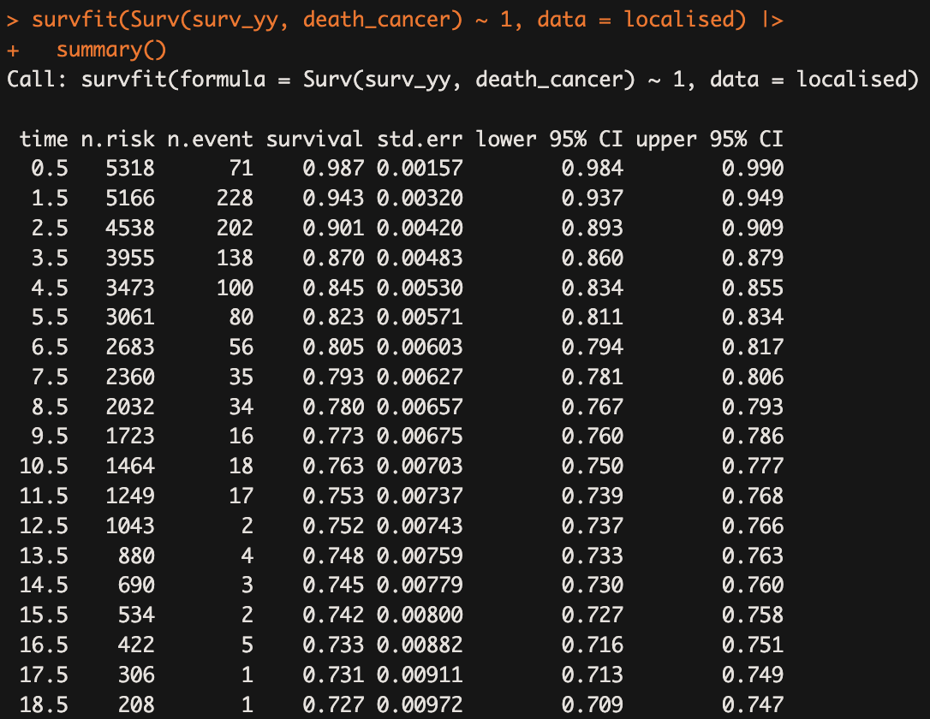
4. Localized melanoma: comparing actuarial and Kaplan-Meier approaches
a) Is the Kaplan-Meier or actuarial approach more appropriate when using survival time in years?
Notes:
When dealing with survival data measured in years, the actuarial method is often more advantageous.
Kaplan-Meier (KM) Method
KM estimates are based on exact event times, which can lead to unnecessary complexity and volatility in data measured over years. This method is more useful when time intervals are shorter (e.g., months or days) and exact timing is critical.
The KM method calculates survival for each unique event time, which can be over-detailed when data is in years,
Actuarial (Life-Table) Method
By dividing time into yearly intervals, the actuarial method smooths out survival estimates, providing a clearer overview of long-term trends without the noise from exact event timing.
The actuarial approach accounts for censoring by adjusting the number at risk within each interval. This can be especially helpful for yearly data, where losses to follow-up and censored cases accumulate over time.
Yearly intervals offer a stable summary of survival, which is particularly useful in clinical and epidemiological studies that focus on long-term outcomes, like 5- or 10-year survival rates.

Slide 15
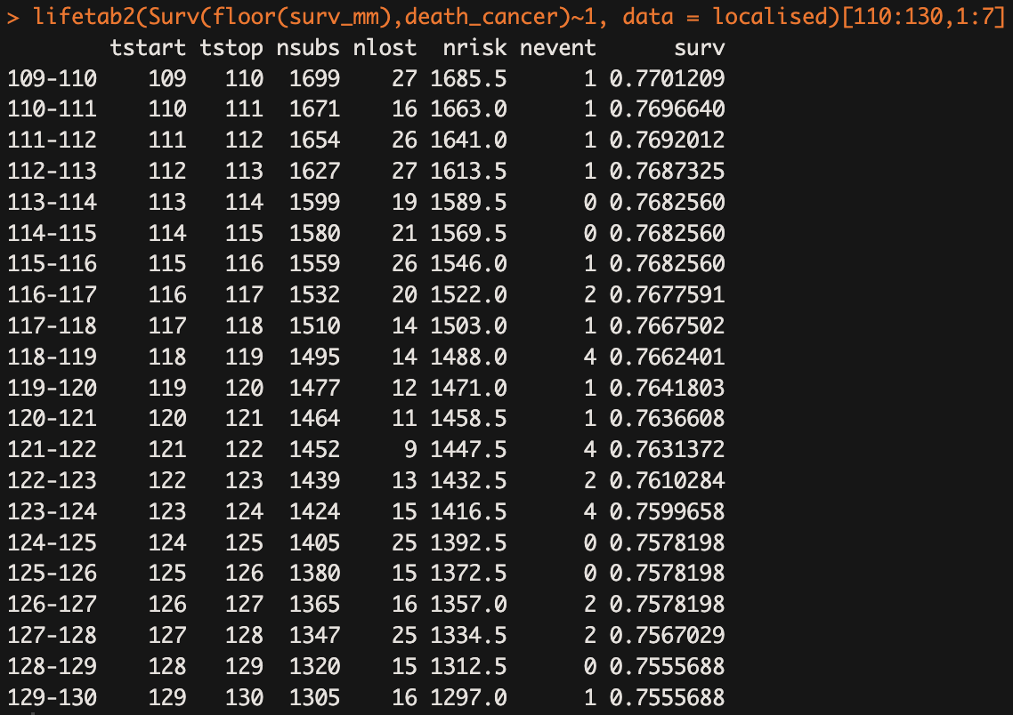
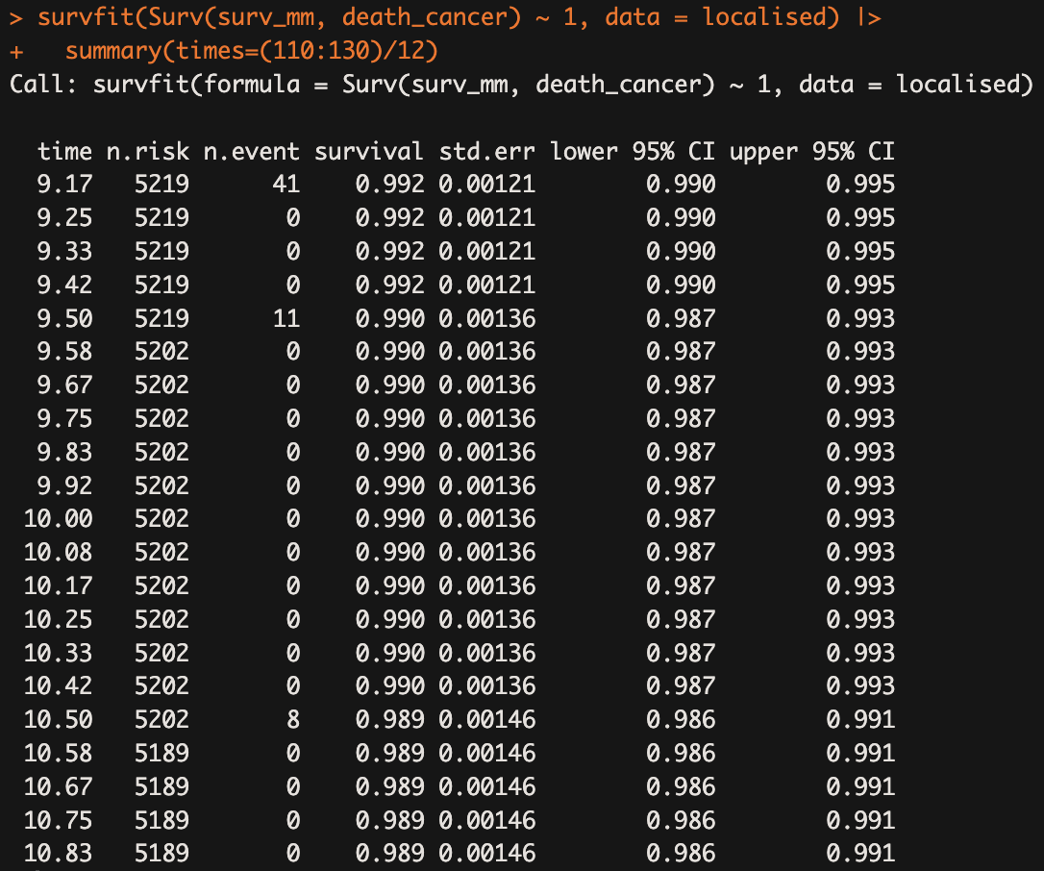
b) Is the Kaplan-Meier or actuarial approach more appropriate when using survival time in months?
Notes:
The Kaplan-Meier estimator is often considered superior when analyzing survival data measured in months (or other small time intervals) for several reasons:
Exact Event Timing: The Kaplan-Meier method calculates survival probabilities using the exact time points at which events occur. → precise
Better Tie Handling: When using smaller intervals, there are likely to be less events that happen at the same time, which can lead to more accurate estimates. In contrast, larger intervals (like years) might cause more ties and less precision in the estimates.
More Data Points: By measuring survival in months, there are more data points available for analysis. This increased frequency allows the Kaplan-Meier estimator to reflect changes in survival probabilities more accurately.
Early Survival Dynamics: Many survival events (such as deaths) occur shortly after diagnosis. Having more detailed time intervals (in months) enables the capture of these early dynamics, which are crucial for understanding the course of the disease and treatment efficacy.
3. Granularity and Statistical Power:
Higher Resolution: Monthly data provides higher resolution, which can capture small fluctuations in survival probability that may be significant for clinical interpretations.
Statistical Power: More data points (due to smaller time intervals) can enhance the statistical power of tests (e.g., comparing survival curves), making it easier to detect significant differences between groups.
4. Flexibility in Analysis:
Customization: The Kaplan-Meier estimator allows for the analysis of different time frames and can accommodate complex censoring patterns. For instance, if patients drop out or are lost to follow-up, their data can still be effectively utilized without needing to aggregate it into larger time frames.
Visual Representation: The Kaplan-Meier curve can provide clear visualizations of survival probabilities over time, making it easier to interpret and communicate results, particularly when more data points are available.
5. Improved Confidence Intervals:
More Precise Estimates: Confidence intervals calculated with Kaplan-Meier for smaller intervals can be tighter and more reflective of the true survival experience of the cohort being studied.

Slide 16

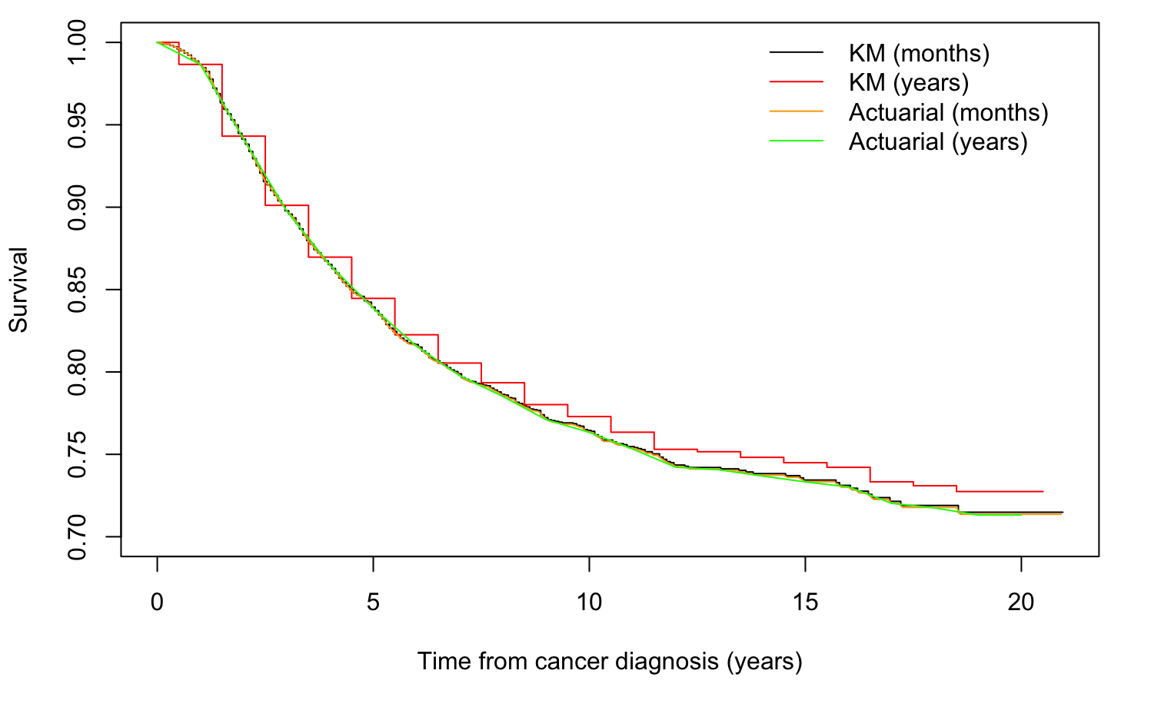
c) Plot the curves and compare the results
Notes:
lifetab2(...): This function is likely part of a survival analysis package in R that computes actuarial survival estimates. It uses the Surv object created from the surv_yy variable (which presumably represents survival time in years) and the death_cancer variable (indicating whether death occurred due to cancer).
floor(surv_yy): This function call rounds down the survival time to the nearest whole number (i.e., it uses complete years for the actuarial calculations).
~ 1: This part of the formula indicates that the survival estimates are calculated without any covariates (i.e., it's a non-stratified analysis).
We see that KM and actuarial approach show similar results. The only outlier is the KM in years. → talk a bit more about that
Overlap of Curves: The actuarial method for both months and years as well as the Kaplan-Meier (KM) method for months closely follow the same survival curve. This suggests that these methods yield very similar estimates of survival probabilities over time, indicating that they capture the underlying survival distribution effectively for the dataset being analyzed.
Divergence of KM in Years: The Kaplan-Meier method for years may suggest that there are issues with how the time intervals are treated when using years, possibly leading to a loss of information or precision compared to the monthly data.

