Slide 1
Biostat III: Lab 3 review
Yunyang Deng

Slide 2
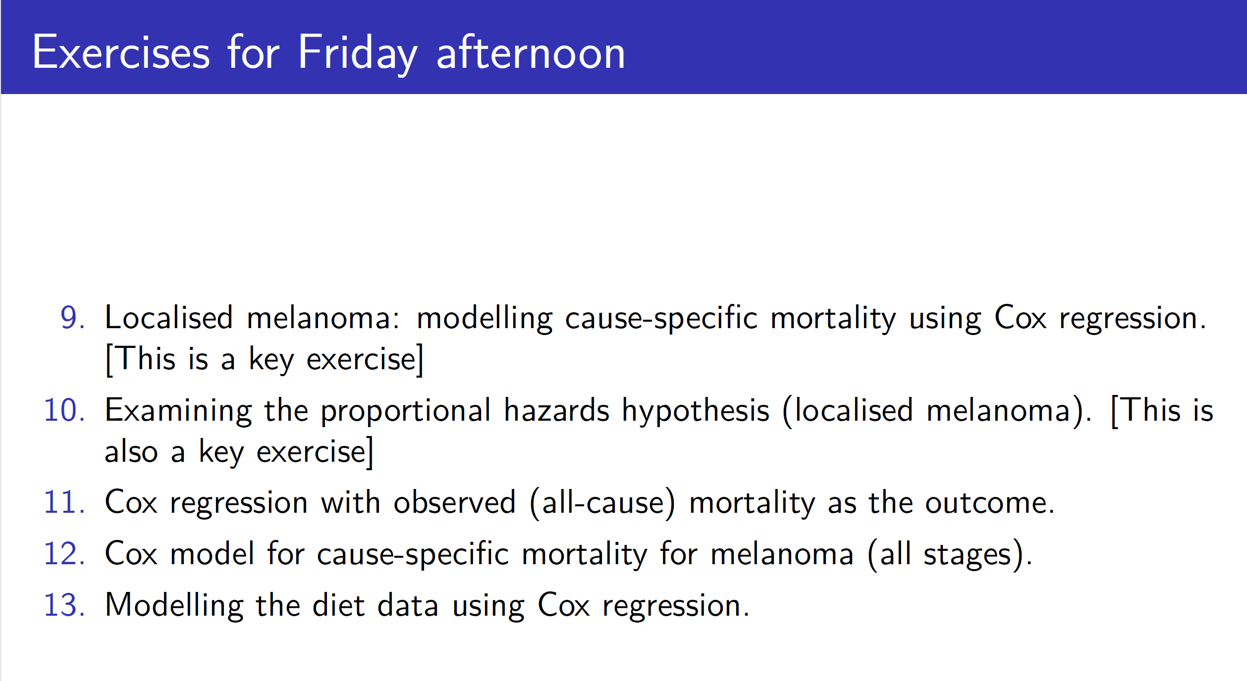

Slide 3
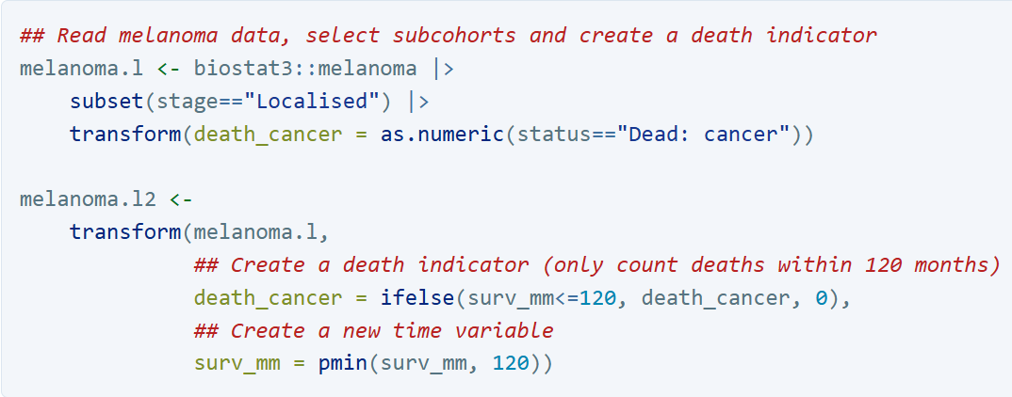
Exercise 9. Localised melanoma: modelling cause-specific mortality using Cox regression
First, let’s censor all survival times at 120 months (10 years) to facilitate comparisons with the Poisson regression model in exercise 7.

Slide 4
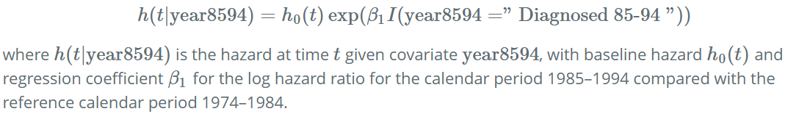
Exercise 9. Localised melanoma: modelling cause-specific mortality using Cox regression
(a). Interpret the estimated hazard ratio, including a comment on statistical significance. Write the regression equation. Draw a graph showing the shape of the fitted hazard rates for the two calendar periods, also indicating the distance between the curves (HINT: draw on the log hazard scale if you find it easier). Compare this to how you drew the graph in exercise 7h.

Slide 5

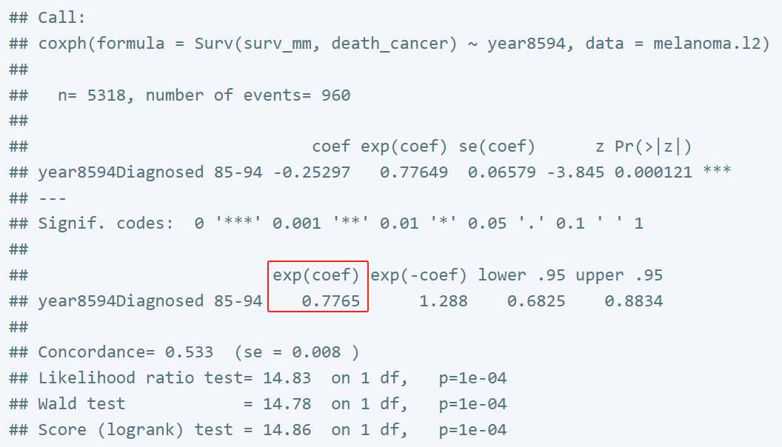
Exercise 9. Localised melanoma: modelling cause-specific mortality using Cox regression
(a). Interpret the estimated hazard ratio, including a comment on statistical significance. Write the regression equation. Draw a graph showing the shape of the fitted hazard rates for the two calendar periods, also indicating the distance between the curves (HINT: draw on the log hazard scale if you find it easier). Compare this to how you drew the graph in exercise 7h.
Patients diagnosed during 1985–94 experience only 77.7% of the cancer mortality rate experienced by those diagnosed 1975–84. That is, mortality due to skin melanoma has decreased by 22.3% in the latter period compared to the earlier period.

Slide 6
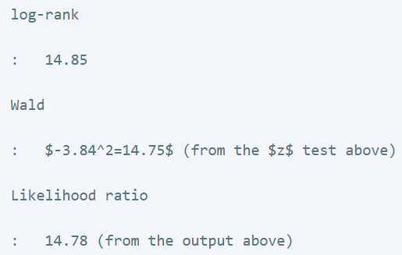
Exercise 9. Localised melanoma: modelling cause-specific mortality using Cox regression
(b). Compare likelihood ratio test and Wald test statistics with each other and with the log rank test statistic (which also has a chi square distribution) calculated in question 3c (you should, however, recalculate the log rank test since we have restricted follow-up to the first 10 years in this exercise). Would you expect these test statistics to be similar? Consider the null and alternative hypotheses of each test and the assumptions involved with each test.
The three test statistics are very similar. We would expect each of these test statistics to be similar since they each test the same null hypothesis that survival is independent of calendar period. The null hypothesis in each case is that survival is not associated with calendar period.

Slide 7
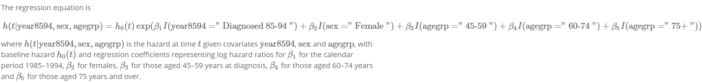
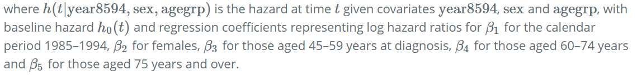
Exercise 9. Localised melanoma: modelling cause-specific mortality using Cox regression
(c). Now include sex and age (in categories) in the model. Write out the regression equation.
i. Interpret the estimated hazard ratio for the parameter labelled agegrp45-59, including a comment on its statistical significance.

Slide 8
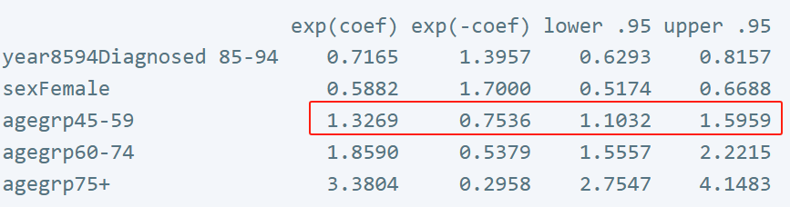
Exercise 9. Localised melanoma: modelling cause-specific mortality using Cox regression
(c). Now include sex and age (in categories) in the model. Write out the regression equation.
i. Interpret the estimated hazard ratio for the parameter labelled agegrp45-59, including a comment on its statistical significance.
For patients of the same sex diagnosed in the same calendar period, those aged 45-59 at diagnosis have an estimated 33% higher risk of death due to skin melanoma than those aged 0–44 at diagnosis. The difference is statistically significant.

Slide 9
Exercise 9. Localised melanoma: modelling cause-specific mortality using Cox regression
(c). Now include sex and age (in categories) in the model. Write out the regression equation.
ii. Is the effect of calendar period strongly confounded by age and sex? That is, does the inclusion of sex and age in the model change the estimate for the effect of calendar period?
Crude HR:
Adjusted HR:
The parameter estimate for period changes from 0.78 to 0.72 when age and sex are added to the model. Whether this is ‘strong confounding’, or even ‘confounding’, is a matter of judgement. I would consider this confounding but not strong confounding but there is no correct answer to this question.

Slide 10
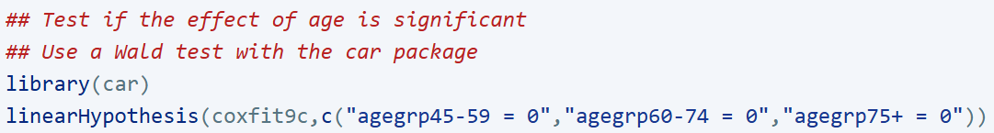
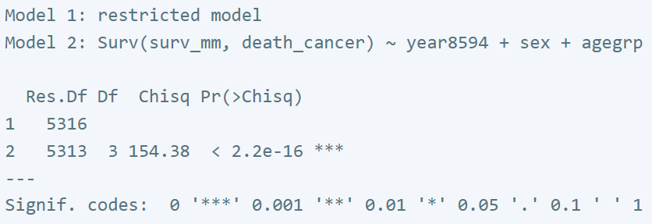
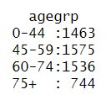
Exercise 9. Localised melanoma: modelling cause-specific mortality using Cox regression
(c). Now include sex and age (in categories) in the model. Write out the regression equation.
iii. Perform a Wald test of the overall effect of age and interpret the results.
Age (modelled as a categorical variable with 4 levels) is highly significant in the model.

Slide 11
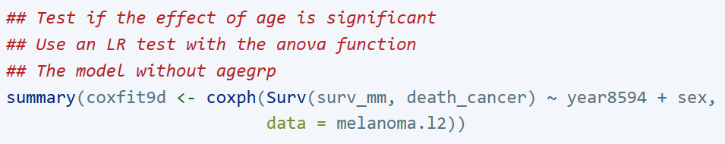
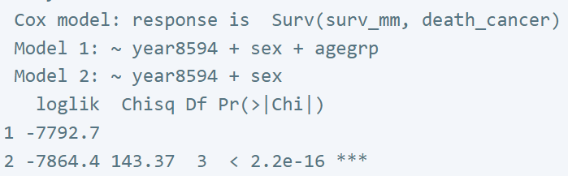

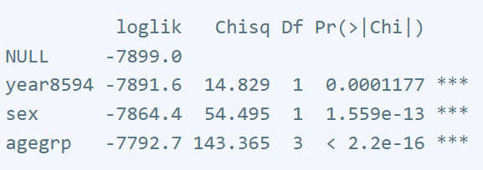

Exercise 9. Localised melanoma: modelling cause-specific mortality using Cox regression
(d). Perform a likelihood ratio test of the overall effect of age and interpret the results.
Age (modelled as a categorical variable with 4 levels) is highly significant in the model. The Wald test is an approximation to the LR test and we would expect the two to be similar (which they are).

Slide 12
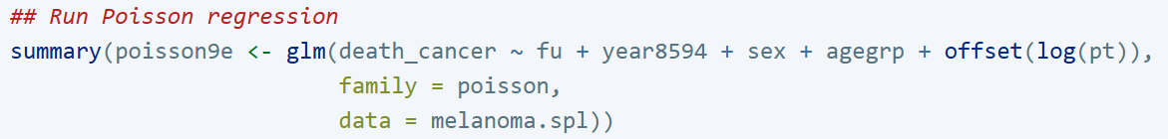
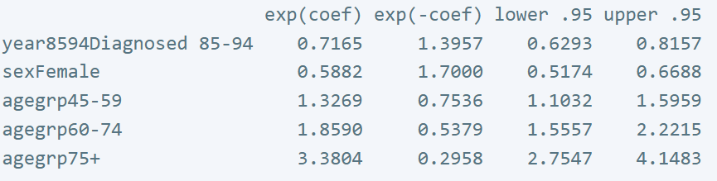
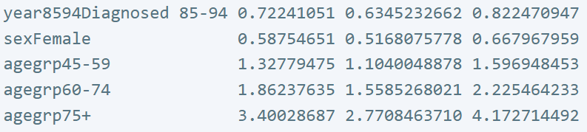
Exercise 9. Localised melanoma: modelling cause-specific mortality using Cox regression
(e). The model estimated in question 9c is similar to the model estimated in question 7i.
i. Both models adjust for sex, year8594, and agegrp but the Poisson regression model in question 7i appears to adjust for an additional variable (fu). Is the Poisson regression model adjusting for an additional factor? Explain.
Both models adjust for the same factors. When fitting the Poisson regression model we split time since diagnosis into annual intervals and explicitly estimated the effect of this factor in the model. The Cox model does not estimate the effect of ‘time’ but the other estimates are adjusted for ‘time’.

Slide 13
Exercise 9. Localised melanoma: modelling cause-specific mortality using Cox regression
(e). The model estimated in question 9c is similar to the model estimated in question 7i.
ii. Would you expect the parameter estimate for sex, period, and age to be similar for the two models? Are they similar?
Since the two models are conceptually similar we would expect the parameter estimates to be similar, which they are.
iii. Do both models assume proportional hazards? Explain.
Yes, both models assume ‘proportional hazards’. The proportional hazards assumption implies that the rate ratios are constant across all levels of follow-up time. In other words, the assumption is that there is no effect modification by follow-up time. This assumption is implicit in Poisson regression (as it is in logistic regression) where it is assumed that estimated rate ratios are constant across all combination of the other covariates. We can, of course, relax this assumption by fitting interaction terms.

Slide 14
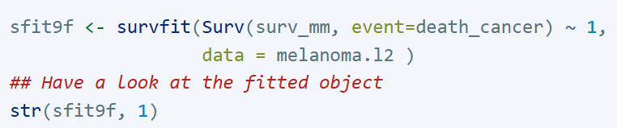
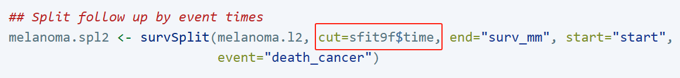
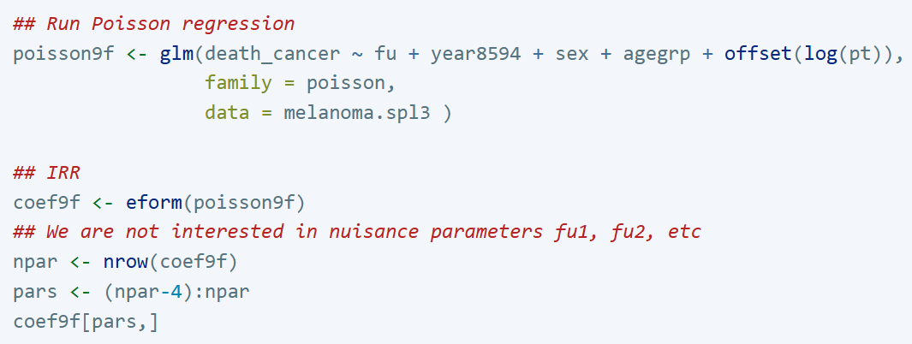
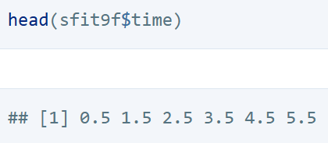

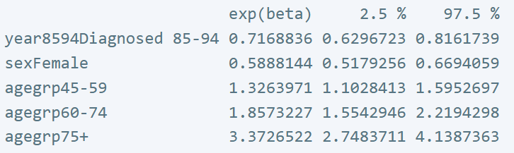
Exercise 9. Localised melanoma: modelling cause-specific mortality using Cox regression
(f). ADVANCED: By splitting at each failure time we can estimate a Poisson regression model that is identical to the Cox model.

Slide 15
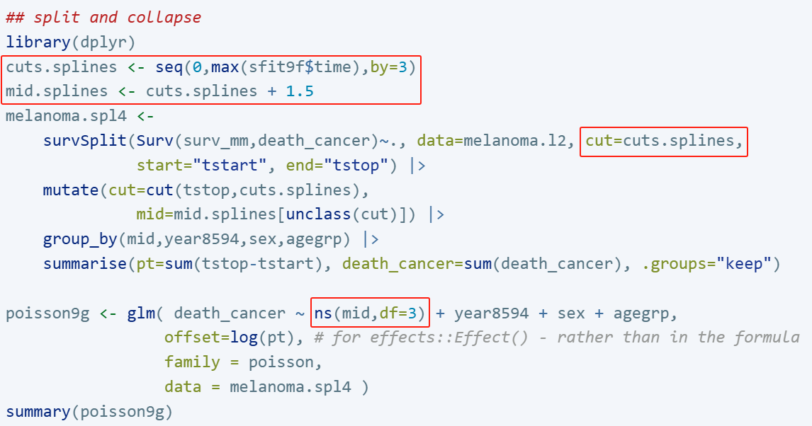
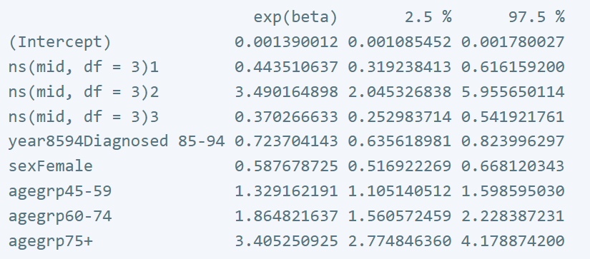
Exercise 9. Localised melanoma: modelling cause-specific mortality using Cox regression
(g). ADVANCED: Split the data finely (e.g., 3-month intervals) and model the effect of time using a restricted cubic spline with Poisson regression. Also plot the rate and survival.
Split by each failure time in (f):
Cox results in (f):

Slide 16
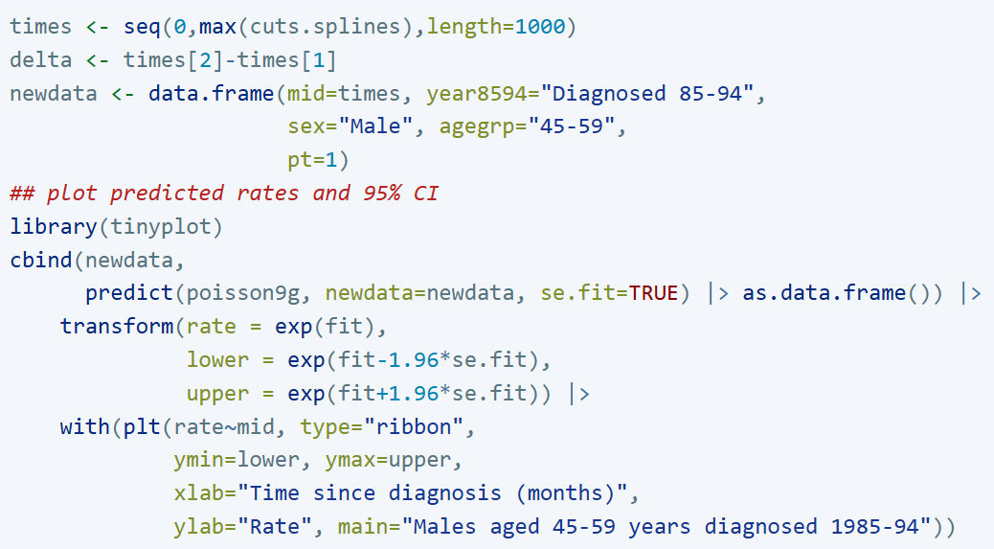
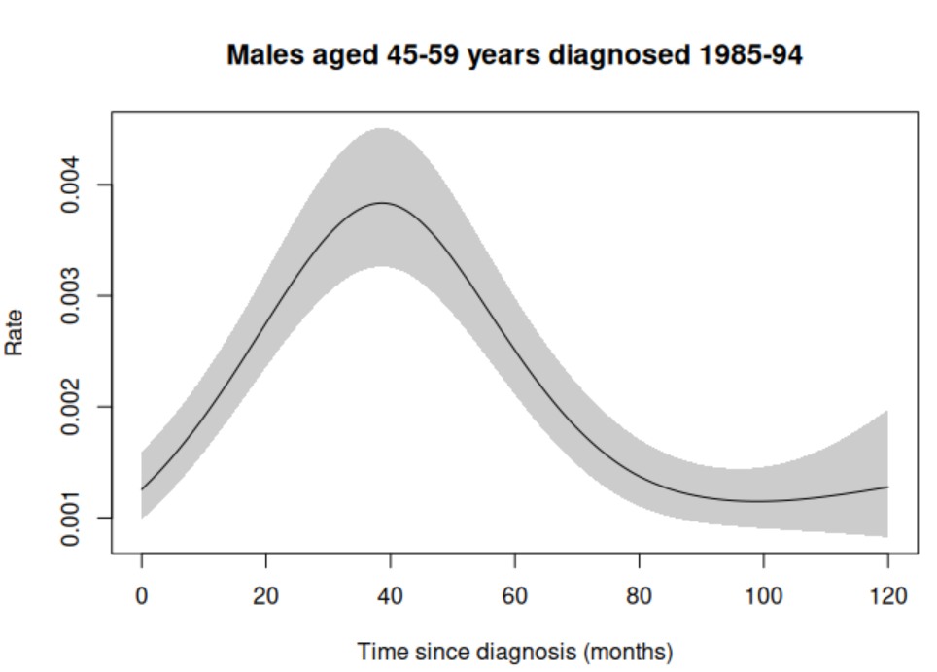
Exercise 9. Localised melanoma: modelling cause-specific mortality using Cox regression
(g). ADVANCED: Split the data finely (e.g., 3-month intervals) and model the effect of time using a restricted cubic spline with Poisson regression. Also plot the rate and survival.

Slide 17
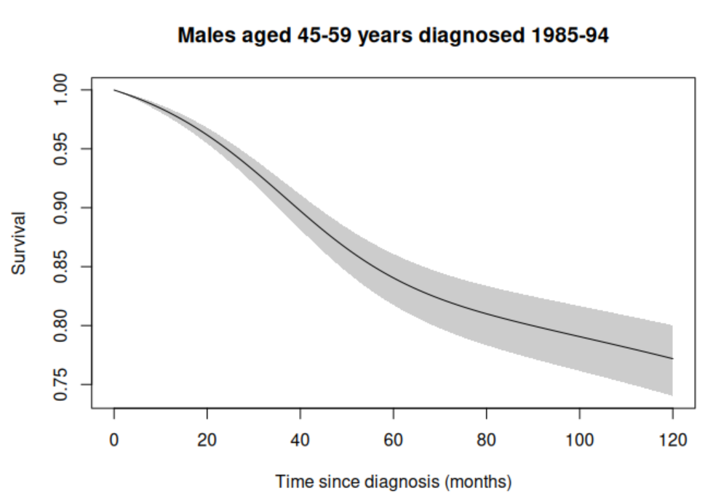
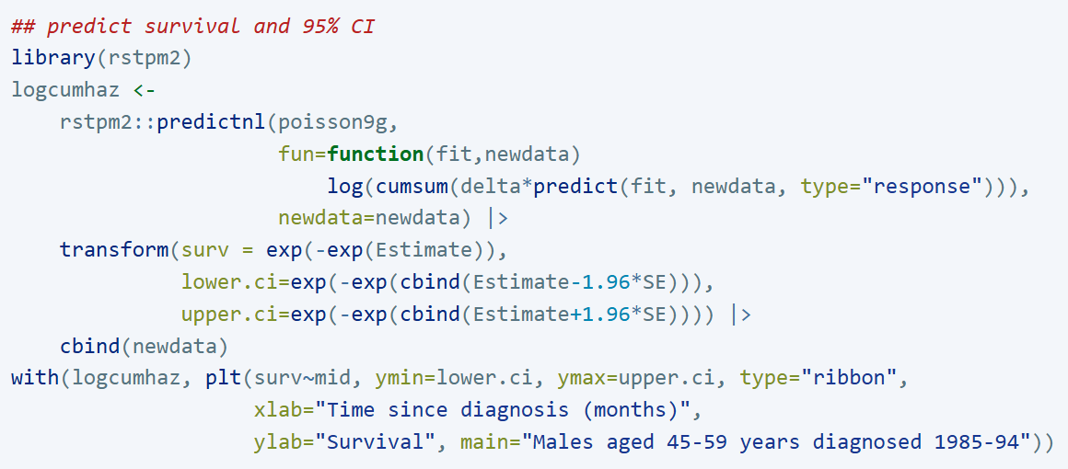
Exercise 9. Localised melanoma: modelling cause-specific mortality using Cox regression
(g). ADVANCED: Split the data finely (e.g., 3-month intervals) and model the effect of time using a restricted cubic spline with Poisson regression. Also plot the rate and survival.

Slide 19
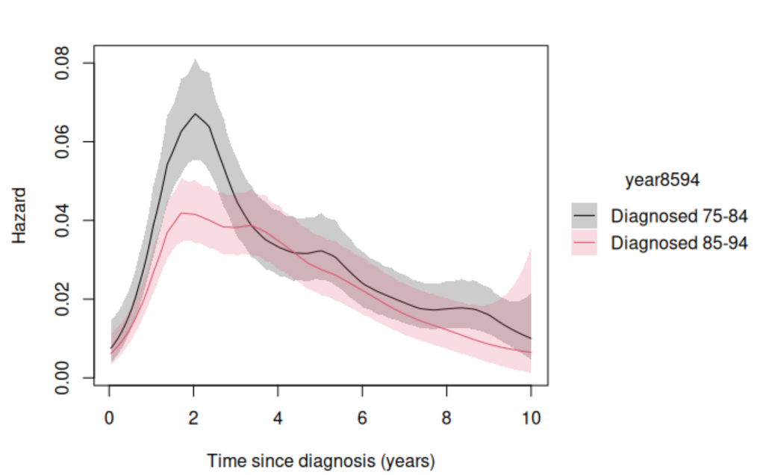
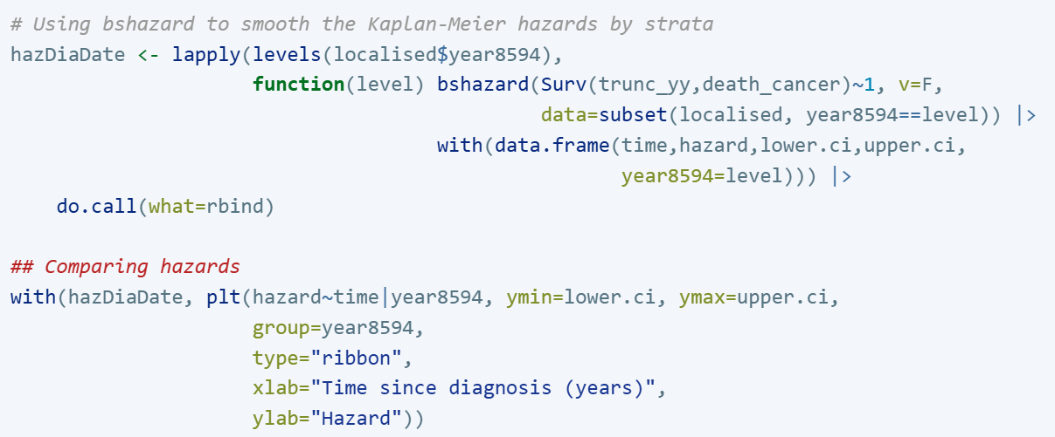
Exercise 10. Examining the proportional hazards hypothesis (localised melanoma)
(a). For the localised melanoma data with 10 years follow-up, plot the instantaneous cause-specific hazard for each calendar period.
If we look at the hazard curves, at their peak the ratio is approximately: 0.040/0.065=0.62. The ratio seems to vary with respect to time.

Slide 20
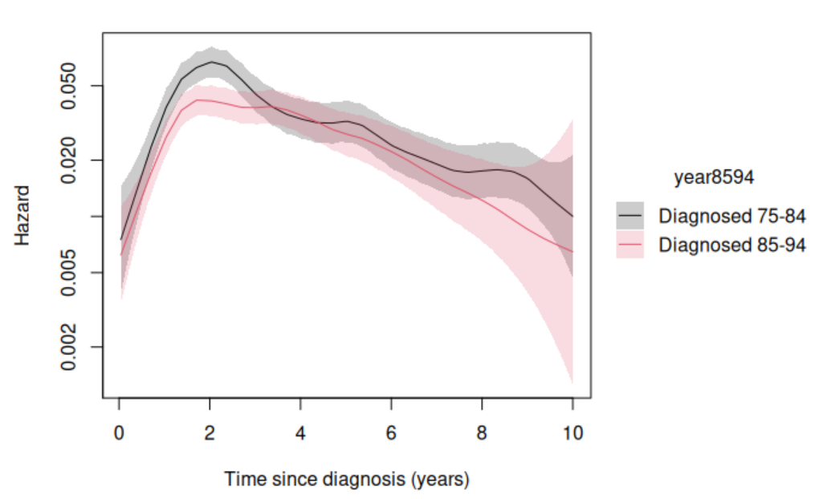
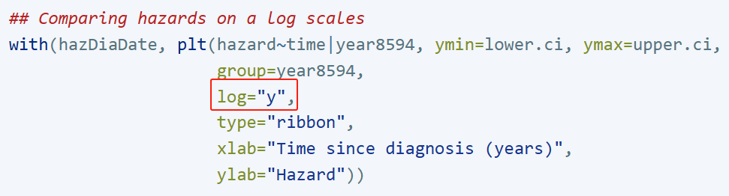
Exercise 10. Examining the proportional hazards hypothesis (localised melanoma)
(b). Now plot the instantaneous cause-specific hazard for each calendar period using a log scale for the y axis (use the option yscale(log)). What would you expect to see if a proportional hazards assumption was appropriate? Do you see it?
There is some evidence against the assumption of proportional hazards since we see non-parallel curves when plotting the instantaneous cause-specific hazard on the log scale.

Slide 21
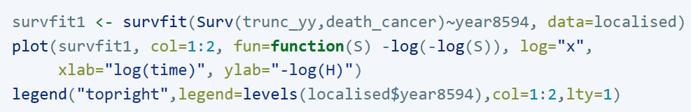
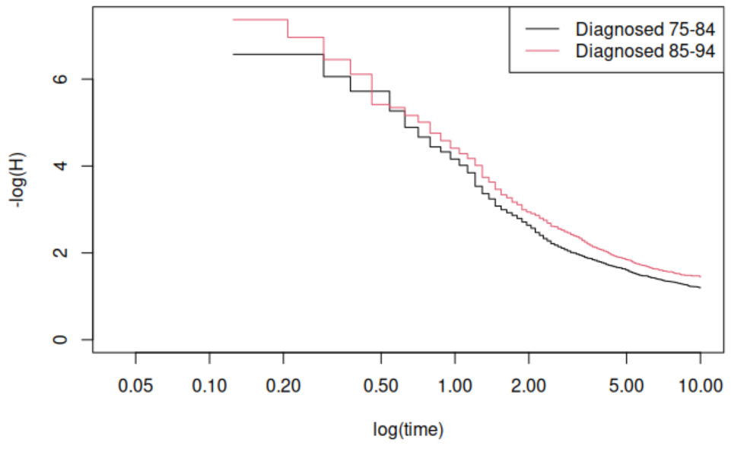
Exercise 10. Examining the proportional hazards hypothesis (localised melanoma)
(c). Another graphical way of checking the proportional hazards assumption is to plot the log cumulative cause specific hazard function for each calendar period.
If the proportional hazards assumption is appropriate then we should see parallel lines. This looks okay; we shouldn’t put too much weight on the fact that the curves cross early in the follow-up since there are so few deaths there.
The difference between the two log-cumulative hazard curves is similar during the part of the follow-up where we have the most information (most deaths).
Note that these curves are not based on the estimated Cox model (i.e., they are unadjusted).

Slide 22
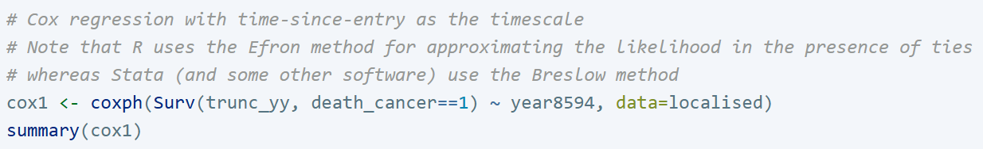
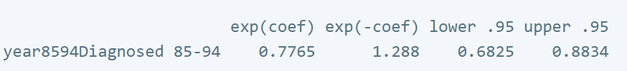
Exercise 10. Examining the proportional hazards hypothesis (localised melanoma)
(d). Compare your estimated hazard ratio from part (a) with the one from a fitted Cox model with calendar period as the only explanatory variable. Are they similar?
The estimated hazard ratio from the Cox model is 0.78, which is higher than the estimate made by looking at the hazard function plot (0.040/0.065=0.62).

Slide 23
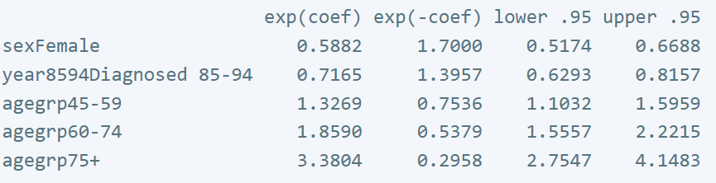
Exercise 10. Examining the proportional hazards hypothesis (localised melanoma)
(e). Now fit a more complex model and use graphical methods to explore the assumption of proportional hazards by calendar period.

Slide 24
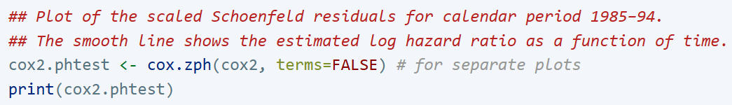
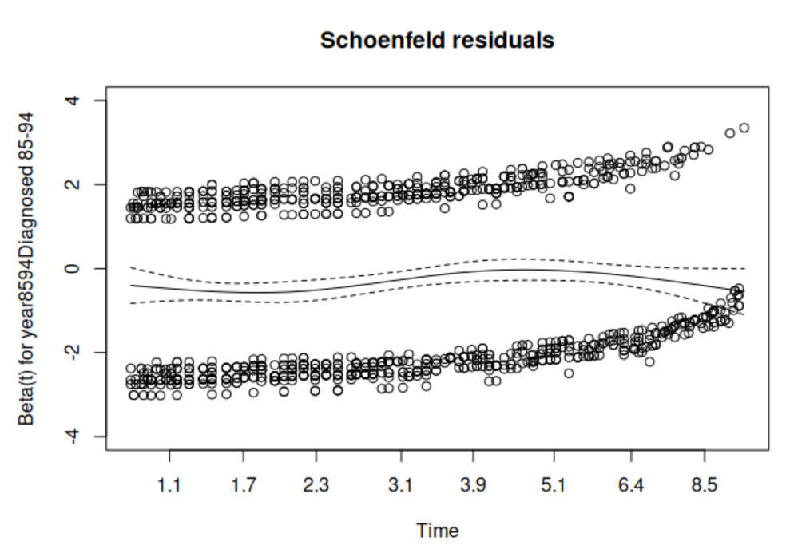
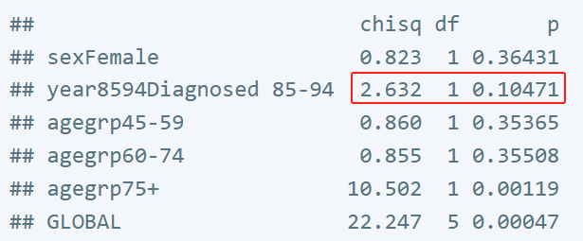
Exercise 10. Examining the proportional hazards hypothesis (localised melanoma)
(e). Now fit a more complex model and use graphical methods to explore the assumption of proportional hazards by calendar period.
The plot of the scaled Schoenfeld residuals for the effect of period. Under proportional hazards, the smoother will be a horizontal line. The line does vary (with possibly an increasing log hazard ratio at around 4 years), but not in a linear pattern, which is consistent with the p-value of 0.10 for linear trend.

Slide 25
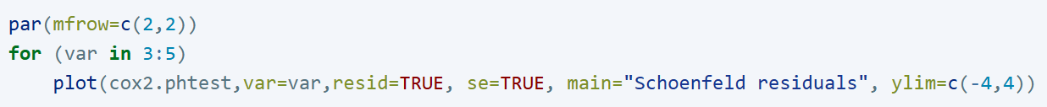
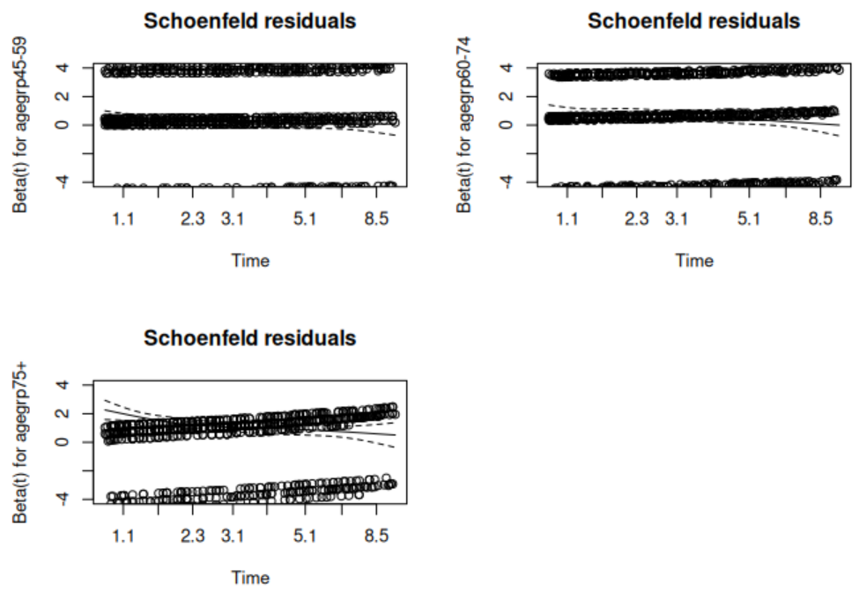
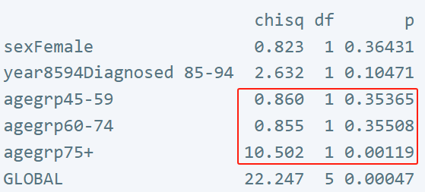
Exercise 10. Examining the proportional hazards hypothesis (localised melanoma)
(f). Do plot the Schoenfeld residual plots for the variable agegrp. What are your conclusions regarding the assumption of proportional hazards by age group?
Based on the tests for linear trends, we expect a trend for the log hazard ratio comparing ages less than 45 years with those aged 75 years and over. All three log hazard ratios tend to decrease by time of diagnosis, while the trend is more marked for the oldest age group (75+). There is evidence for non-proportionality, particularly for those patients aged 75 years and over.

Slide 26
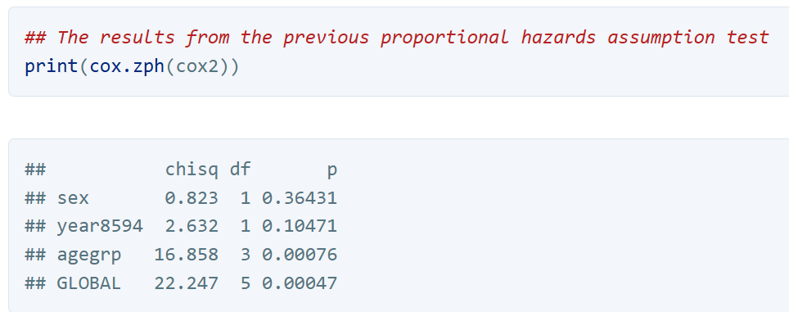
Exercise 10. Examining the proportional hazards hypothesis (localised melanoma)
(g). Now formally test the assumption of proportional hazards.
It seems that there is evidence of non-proportional hazards by age (particularly for the comparison of the oldest to youngest) but not for calendar period. The plot of Schoenfeld residuals suggested non-proportionality for period but this was not statistically significant.

Slide 27
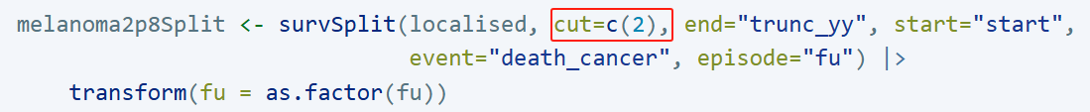
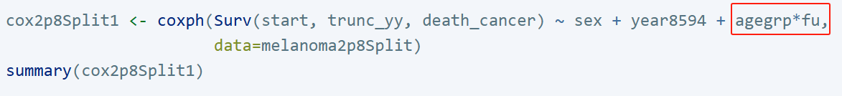
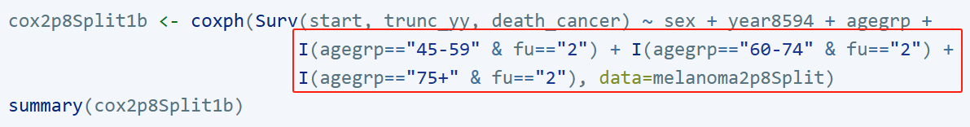
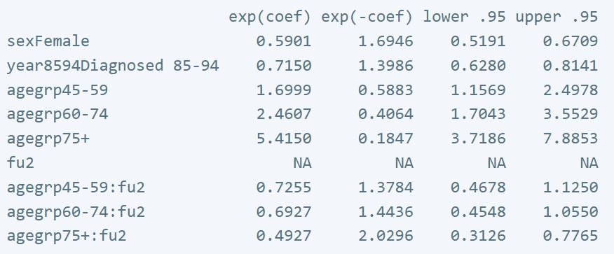
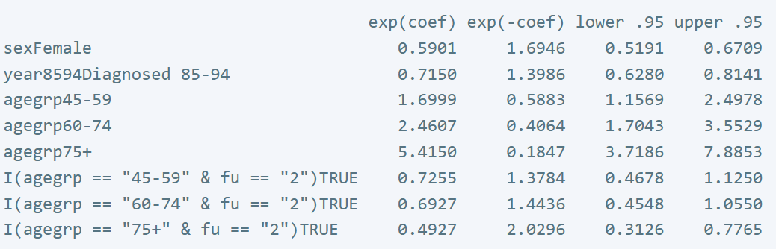
Exercise 10. Examining the proportional hazards hypothesis (localised melanoma)
(h). Estimate separate age effects for the first two years of follow-up (and separate estimates for the remainder of the follow-up) while controlling for sex and period. Do the estimates for the effect of age differ between the two periods of follow-up? Write out the regression equation.

Slide 28
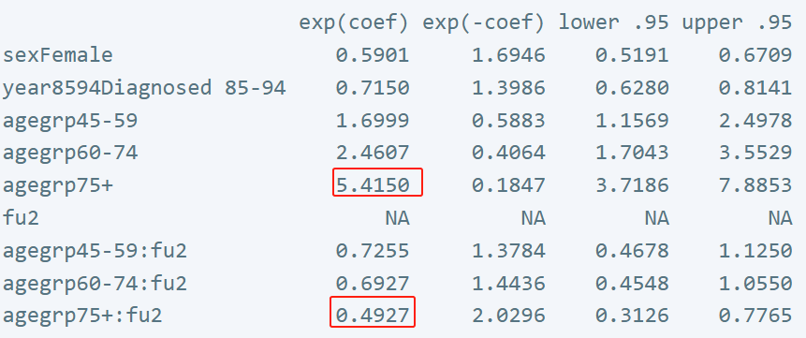

Exercise 10. Examining the proportional hazards hypothesis (localised melanoma)
(h). Estimate separate age effects for the first two years of follow-up (and separate estimates for the remainder of the follow-up) while controlling for sex and period. Do the estimates for the effect of age differ between the two periods of follow-up? Write out the regression equation.
The hazard ratios for age in the top panel are for the first two years subsequent to diagnosis. To obtain the hazard ratios for the period two years or more following diagnosis we multiply the hazard ratios in the top and bottom panel. That is, during the first two years following diagnosis patients aged 75 years or more at diagnosis have 5.4 times higher cancer-specific mortality than patients aged 0–44 at diagnosis. During the period two years or more following diagnosis the corresponding hazard ratio is 5.4*0.49=2.66.

Slide 29


Exercise 10. Examining the proportional hazards hypothesis (localised melanoma)
(h). Estimate separate age effects for the first two years of follow-up (and separate estimates for the remainder of the follow-up) while controlling for sex and period. Do the estimates for the effect of age differ between the two periods of follow-up? Write out the regression equation.

Slide 30



Exercise 10. Examining the proportional hazards hypothesis (localised melanoma)
(i). Now let’s reparameterise the model to directly estimate the effects of age for each level of time since diagnosis.
During the period two years or more following diagnosis the corresponding hazard ratio is 5.4*0.49=2.66.

Slide 31


Exercise 10. Examining the proportional hazards hypothesis (localised melanoma)
(i). Now let’s reparameterise the model to directly estimate the effects of age for each level of time since diagnosis.
s
During the period two years or more following diagnosis the corresponding hazard ratio is 5.4*0.49=2.66.

Slide 32


Exercise 10. Examining the proportional hazards hypothesis (localised melanoma)
(i). Write out the regression equations for models cox2p8Split2 and cox2p8tvct. Based on model cox2p8tvct, write out a formula for the hazard ratio for those aged 75 years and over compared with those aged less than 45 years as a function of time.

Slide 33


Exercise 10. Examining the proportional hazards hypothesis (localised melanoma)
(j). ADVANCED: Fit an analogous Poisson regression model. Are the parameter estimates similar? Calculate and plot the rates.
Fitting for an interaction between age 75+ and time from diagnosis, we get a rate ratio for those aged 75 years at 0.5 years from diagnosis of 5.09 (95% confidence interval (CI): 3.56, 7.29), while at 2 years the rate ratio is 3.82 (95% CI: 3.00, 4.86).

Slide 35

Exercise 11. Cox regression with all-cause mortality as the outcome
(a). Interpret the estimated hazard ratio for the parameter labelled agegrp60-74, including a comment on statistical significance.
For patients of the same sex diagnosed in the same period, those aged 60–74 at diagnosis have a 2.94 times higher risk of death due to any causes than those aged 0–44 at diagnosis. The 95% confidence interval is (2.52, 3.44). This difference is statistically significant.

Slide 36


Exercise 11. Cox regression with all-cause mortality as the outcome
(b). On comparing the estimates between the observed and cause-specific survival models it appears that only the parameters for age have changed substantially. Can you explain why the estimates for the effect of age would be expected to change more than the estimates of the effect of sex and period?
Note that the previous model estimated cause-specific hazard ratios whereas the current model estimates all-cause hazard ratios. The estimated hazard ratios for sex and period are similar, whereas the estimated hazard ratios for age are markedly different. This is because non-cancer mortality is heavily dependent on age, but only lightly dependent on sex and calendar period.

Slide 38


Exercise 12. Cox model for cause-specific mortality for melanoma (all stages)
(a). First fit the model with sex as the only explanatory variable. Does there appear to be a difference in survival between males and females?
Without adjusting for potential confounders, we see that females have a 37% lower mortality rate than males.

Slide 39


Exercise 12. Cox model for cause-specific mortality for melanoma (all stages)
(b). Is the effect of sex confounded by other factors (e.g. age, stage, subsite, period)? After controlling for potential confounders, does there still appear to a difference in survival between males and females?
After adjusting for a range of potential confounders, we see that the estimated difference in cancer-specific mortality between males and females has decreased slightly but there is still quite a large difference.

Slide 40



Exercise 12. Cox model for cause-specific mortality for melanoma (all stages)
(c). Consider the hypothesis that there exists a class of melanomas where female sex hormones play a large role in the etiology. These hormone related cancers are diagnosed primarily in women and are, on average, less aggressive (i.e., prognosis is good). If such a hypothesis were true we might expect the effect of sex to be modified by age at diagnosis (e.g., pre versus post menopausal). Test whether this is the case.
The hazard ratio for males/females in the youngest age group is 0.46, while in the highest age group the hazard ratio is 0.67. There is evidence that the hazard ratios for gender differ across the age groups (p=0.0035).

Slide 41



Exercise 12. Cox model for cause-specific mortality for melanoma (all stages)
(c). Consider the hypothesis that there exists a class of melanomas where female sex hormones play a large role in the etiology. These hormone related cancers are diagnosed primarily in women and are, on average, less aggressive (i.e., prognosis is good). If such a hypothesis were true we might expect the effect of sex to be modified by age at diagnosis (e.g., pre versus post menopausal). Test whether this is the case.
However, after adjusting for stage, subsite, and period there is no longer evidence of an interaction.

Slide 42




Exercise 12. Cox model for cause-specific mortality for melanoma (all stages)
(d). Decide on a ‘most appropriate’ model for these data. Be sure to evaluate the proportional hazards assumption.
There is strong evidence that the proportional hazard assumption is not satisfied for the effect of stage (and also subsite). Unless our primary interest is in the stage effect, we can fit a stratified Cox model where we stratify on stage (i.e. estimate a separate baseline hazard function for each stage group).

Slide 43




Exercise 12. Cox model for cause-specific mortality for melanoma (all stages)
(d). Decide on a ‘most appropriate’ model for these data. Be sure to evaluate the proportional hazards assumption.
If we re-do a test for non-proportional hazards we find that there is no longer evidence that any of the remaining covariates effects seem to depend on time since diagnosis (even for subsite this time).

Slide 44




Exercise 12. Cox model for cause-specific mortality for melanoma (all stages)
(d). Decide on a ‘most appropriate’ model for these data. Be sure to evaluate the proportional hazards assumption.
If you have time make sure you check for additional interaction terms between the remaining covariates, i.e. between age at diagnosis and stage. Having accounted for the time-dependent effect of stage, there is still no evidence that the effect of sex is modified by age at diagnosis.

Slide 46




Exercise 13. Modelling the diet data using Cox regression
(a). Fit the following Poisson regression model to the diet data (we fitted this same model in question 6). Now fit the following Cox model. i. On what scale are we measuring ‘time’ ? That is, what is the timescale? ii. Is it correct to say that both of these models estimate the effect of high energy on CHD without controlling for any potential confounders? If not, how are these models conceptually different? iii. Would you expect the parameter estimates for these two models to be very different? Is there a large difference?
These two models are conceptually different since the Cox model adjusts for ‘time’ even though this is not explicit in the coxph function. In this example, ‘time’ refers to ‘time on study’ (time since entry) which we do not expect to be a strong confounder. That is, we would expect the estimates of the effect of high energy to be similar for the two models, which they are.

Slide 47


Exercise 13. Modelling the diet data using Cox regression
(b). Use the attained age as the timescale and refit the Cox model. Is the estimate of the effect of high energy different? Would we expect it to be different?
If we use a different timescale then this amounts to adjusting for a different factor. As such, we would not expect the estimates to be identical. Attained age, unlike time since entry, is expected to be a confounder but we see that it is not a strong confounder.

